Slide 1

Making Regional Probabilistic Solar Forecasts from Deterministic Forecasts with Open-Source Tools and Data
William B. Hobbs, PE
Southern Company R&D
IEEE PVSC 2024

Slide 2
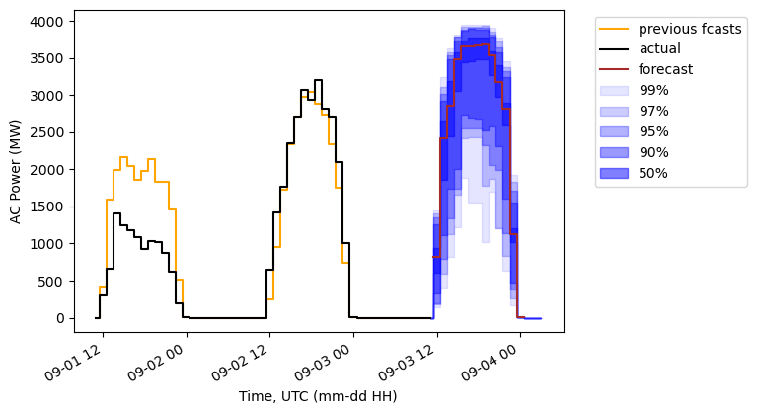


Overview
Open-source tool to produce probabilistic forecast from an existing deterministic forecast (e.g., vendor)
Focus on day-ahead for now
NOAA forecasts
(pvlib+NOAA for prototype)
Vendor PV forecast
ML models
Historical data

Slide 3
Motivation
Lots of good deterministic forecasts are available
None are perfect
Grid operators have increasing need for uncertainty information
Most probabilistic forecasts focus on single sites
Errors across sites are not independent → can’t simply combine site-level probabilistic forecasts

Slide 4


Tools and data
All in python, open-source (and free) tools
pvlib for weather-to-power (forecast and synthetic actuals)
Herbie to retrieve NOAA NWPs from AWS
A portion of this work used code generously provided by Brian Blaylock's Herbie python package (Version 2024.3.1) (https://doi.org/10.5281/zenodo.4567540)
scikit-learn (sklearn) and quantile-forest (based on sklearn, published by Zillow) for ML regression models
Forecasted weather: NOAA GEFS and HRRR
“Actual” weather: NOAA HRRR* f00
Plant specs: EIA Form 860 data**
*Started with NREL NSRDB, but found an issue with cloud detection at low sun angles. Results were mostly the same, otherwise.
** All of SOCO BA

Slide 5
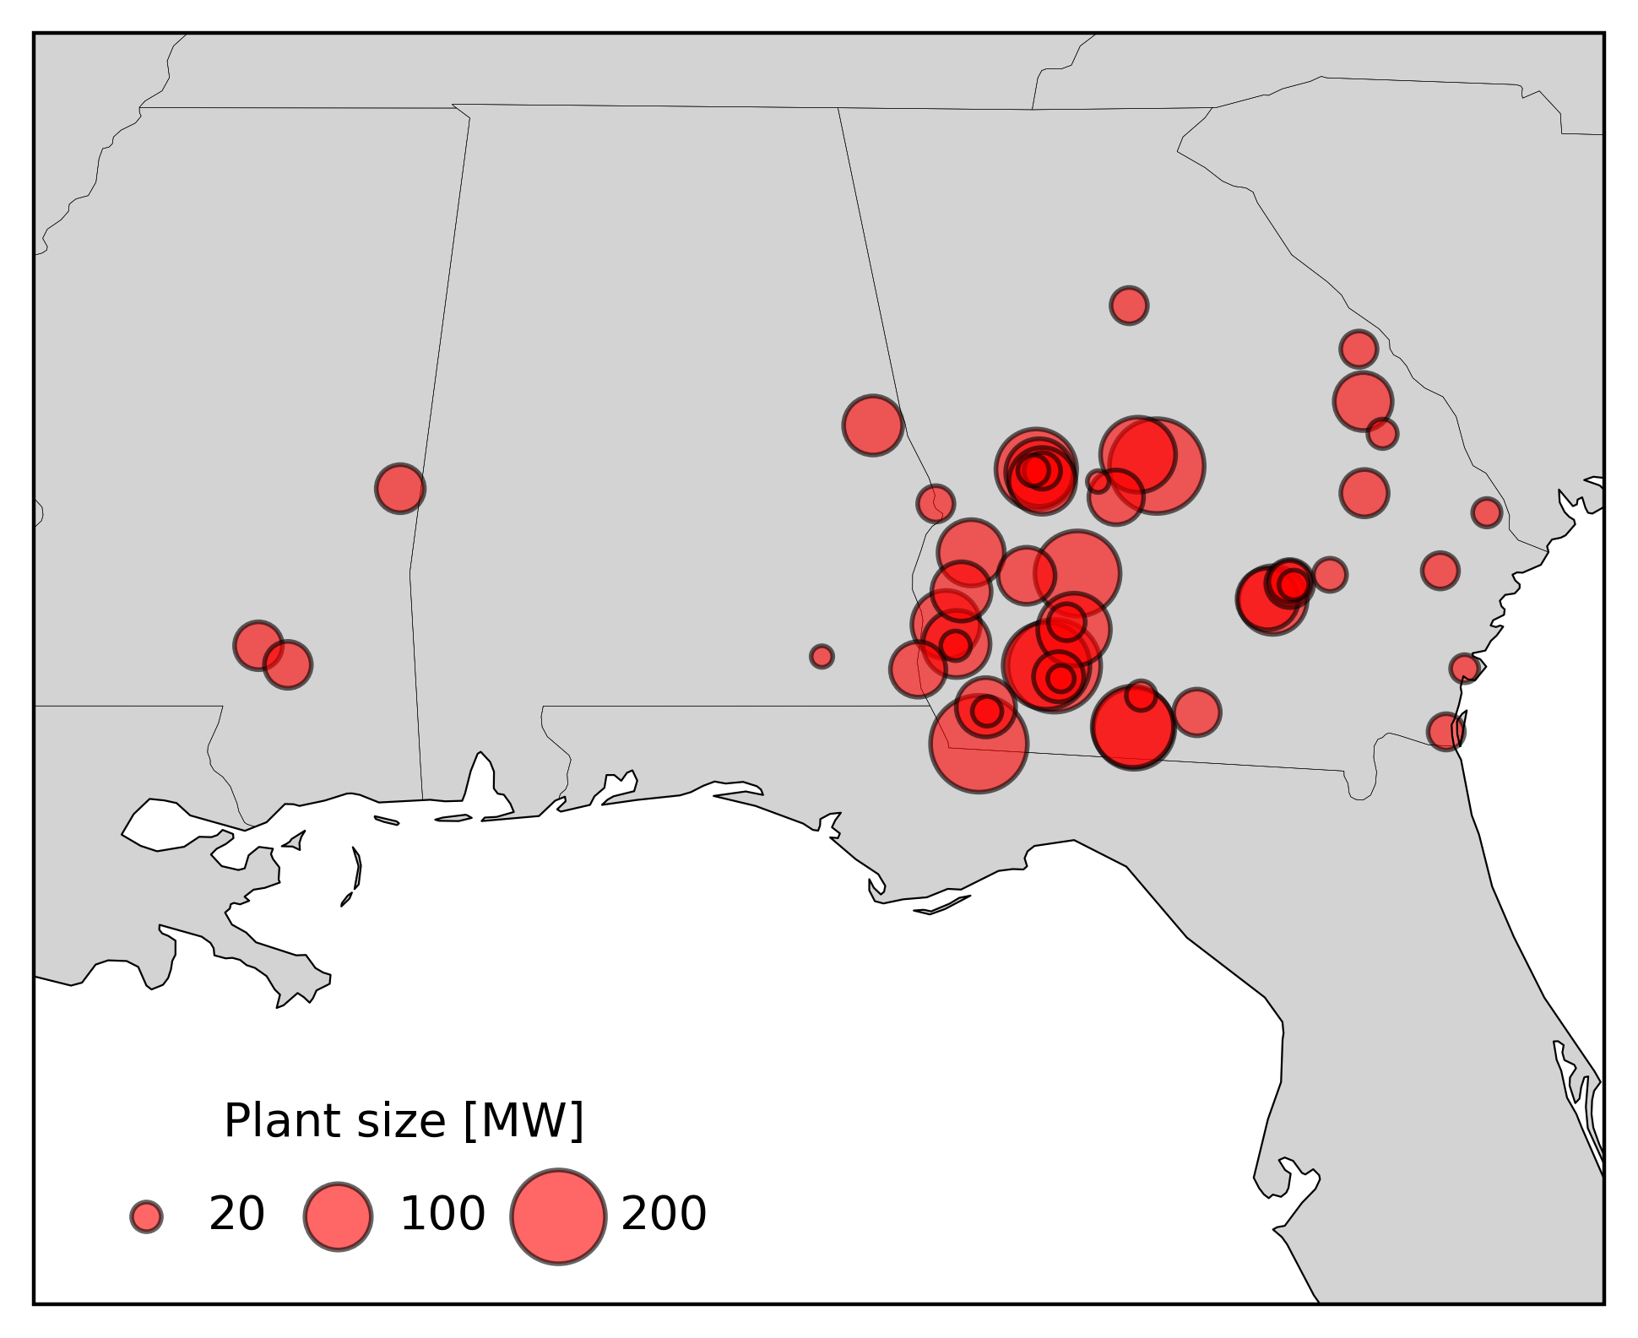
Solar Fleet
About 3700 MW in Southern Company’s Balancing Area
(Improved map by Adam Jensen)

Slide 6
Found two interesting indicators of forecast uncertainty:
Ensemble spread for cloud cover:
Variation in cloud cover across 30 GEFS ensemble members
For each member, calculate average cloud cover over all solar plants, weighted by plant capacity, then calculate standard deviation of those averages across all 30 ensemble members
Spatial variation in irradiance:
Variation of irradiance (and resulting calculated fleet power) across ~30km x 30km HRRR grid (10x10 native grid cells)
(Max – Min)/Clear Sky

Slide 7
Timeout!
Why not just use GEFS for 30 power scenarios and calculate probabilities from that??
Great question! A few reasons:
Ensembles are generally “underdispursed” (overconfident) for solar, i.e., what actually happens too often falls outside the range of all ensemble members
The GEFS model by itself may not be great for solar
I’m not trying to build a full forecast (hard to compete with the best vendors), I want to add probabilities to an existing good forecast

Slide 8
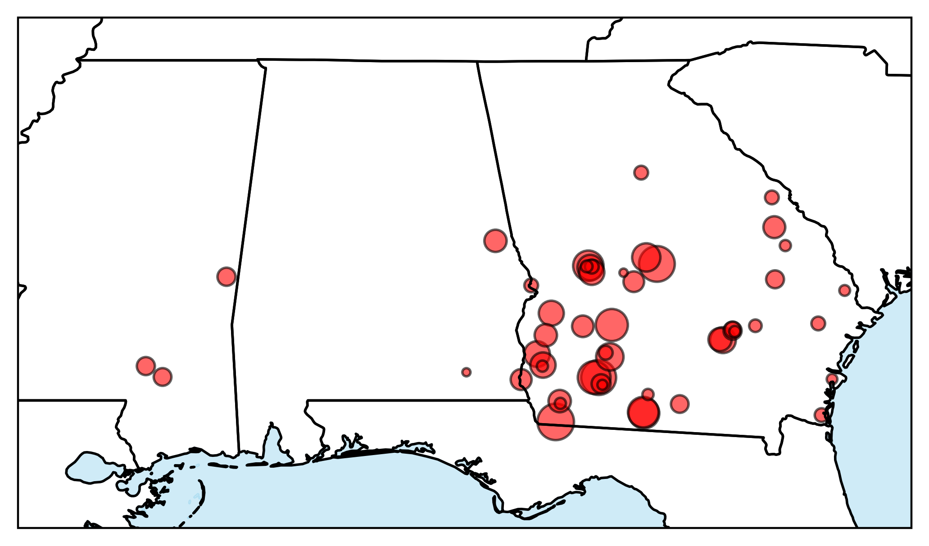


Cloud Cover Uncertainty Examples:
Uncertainty:
LOW

Slide 9







Cloud Cover Uncertainty Examples:
Uncertainty:
High

Slide 10


Cloud Cover Uncertainty Examples:
Uncertainty:
Low/Medium

Slide 11
Real examples:
Low solar, low uncertainty day
(4 ensemble members shown, full analysis includes all 30 members)

Slide 12
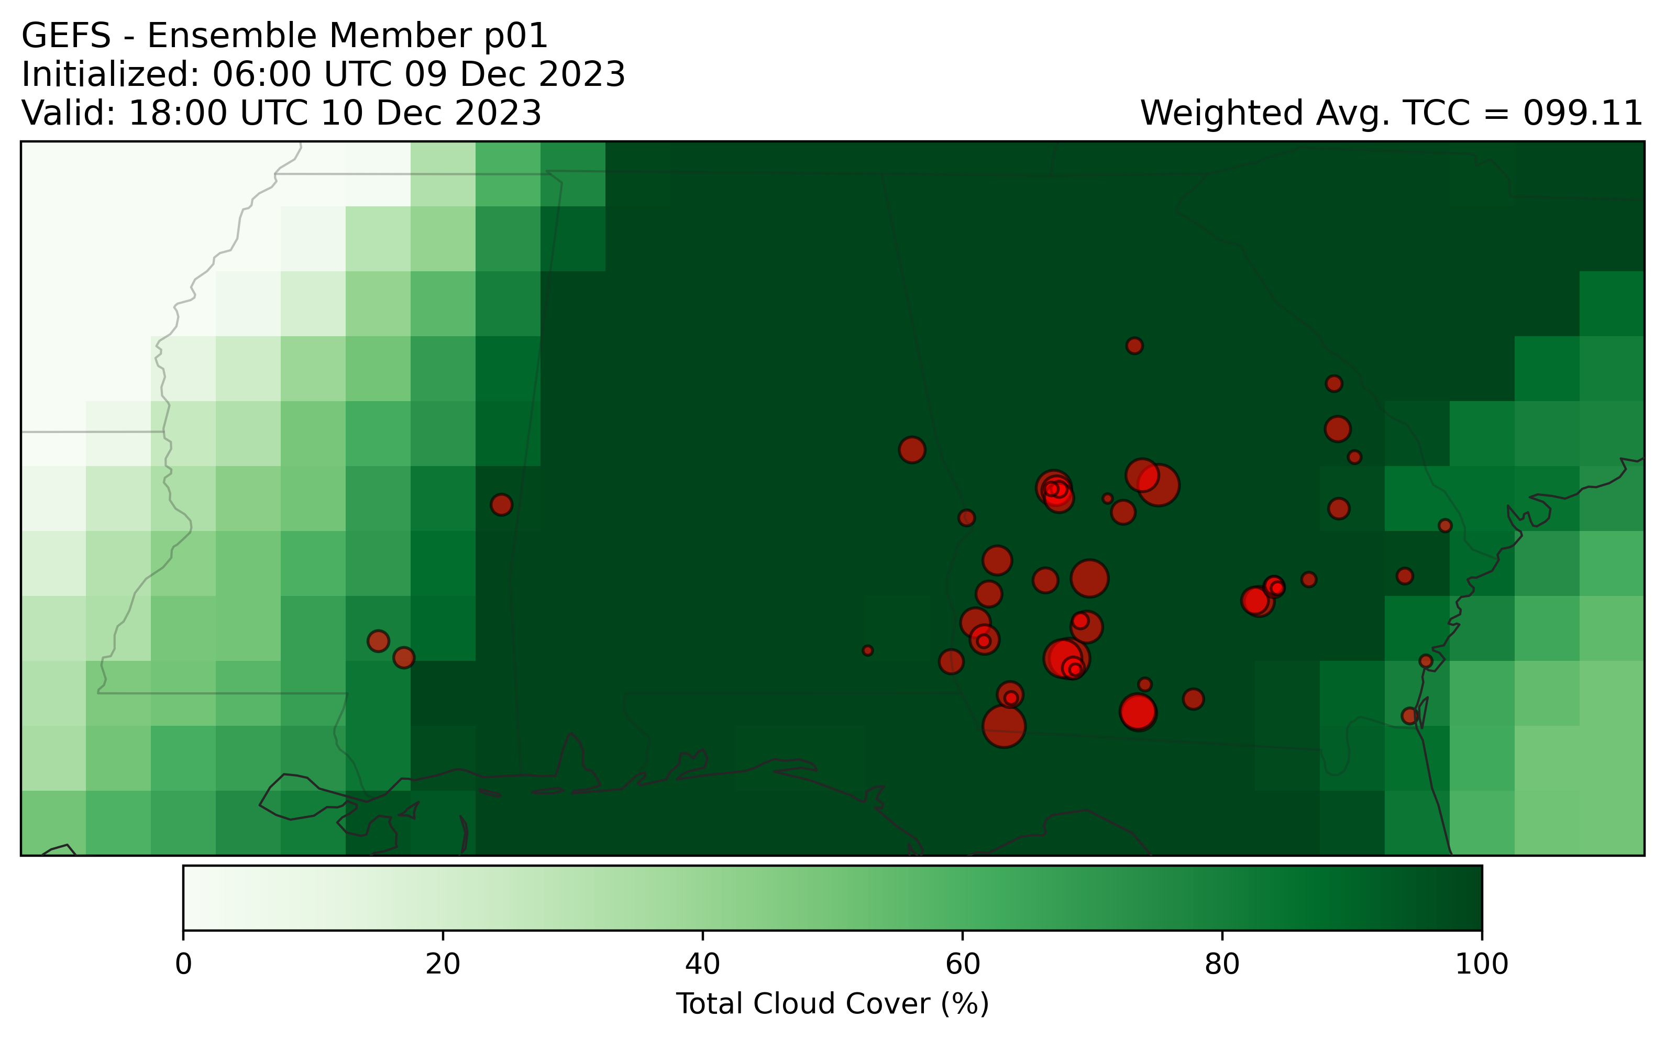

Slide 13
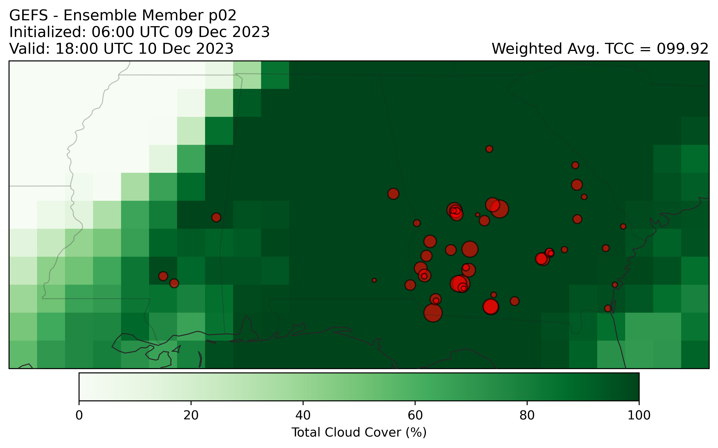

Slide 14
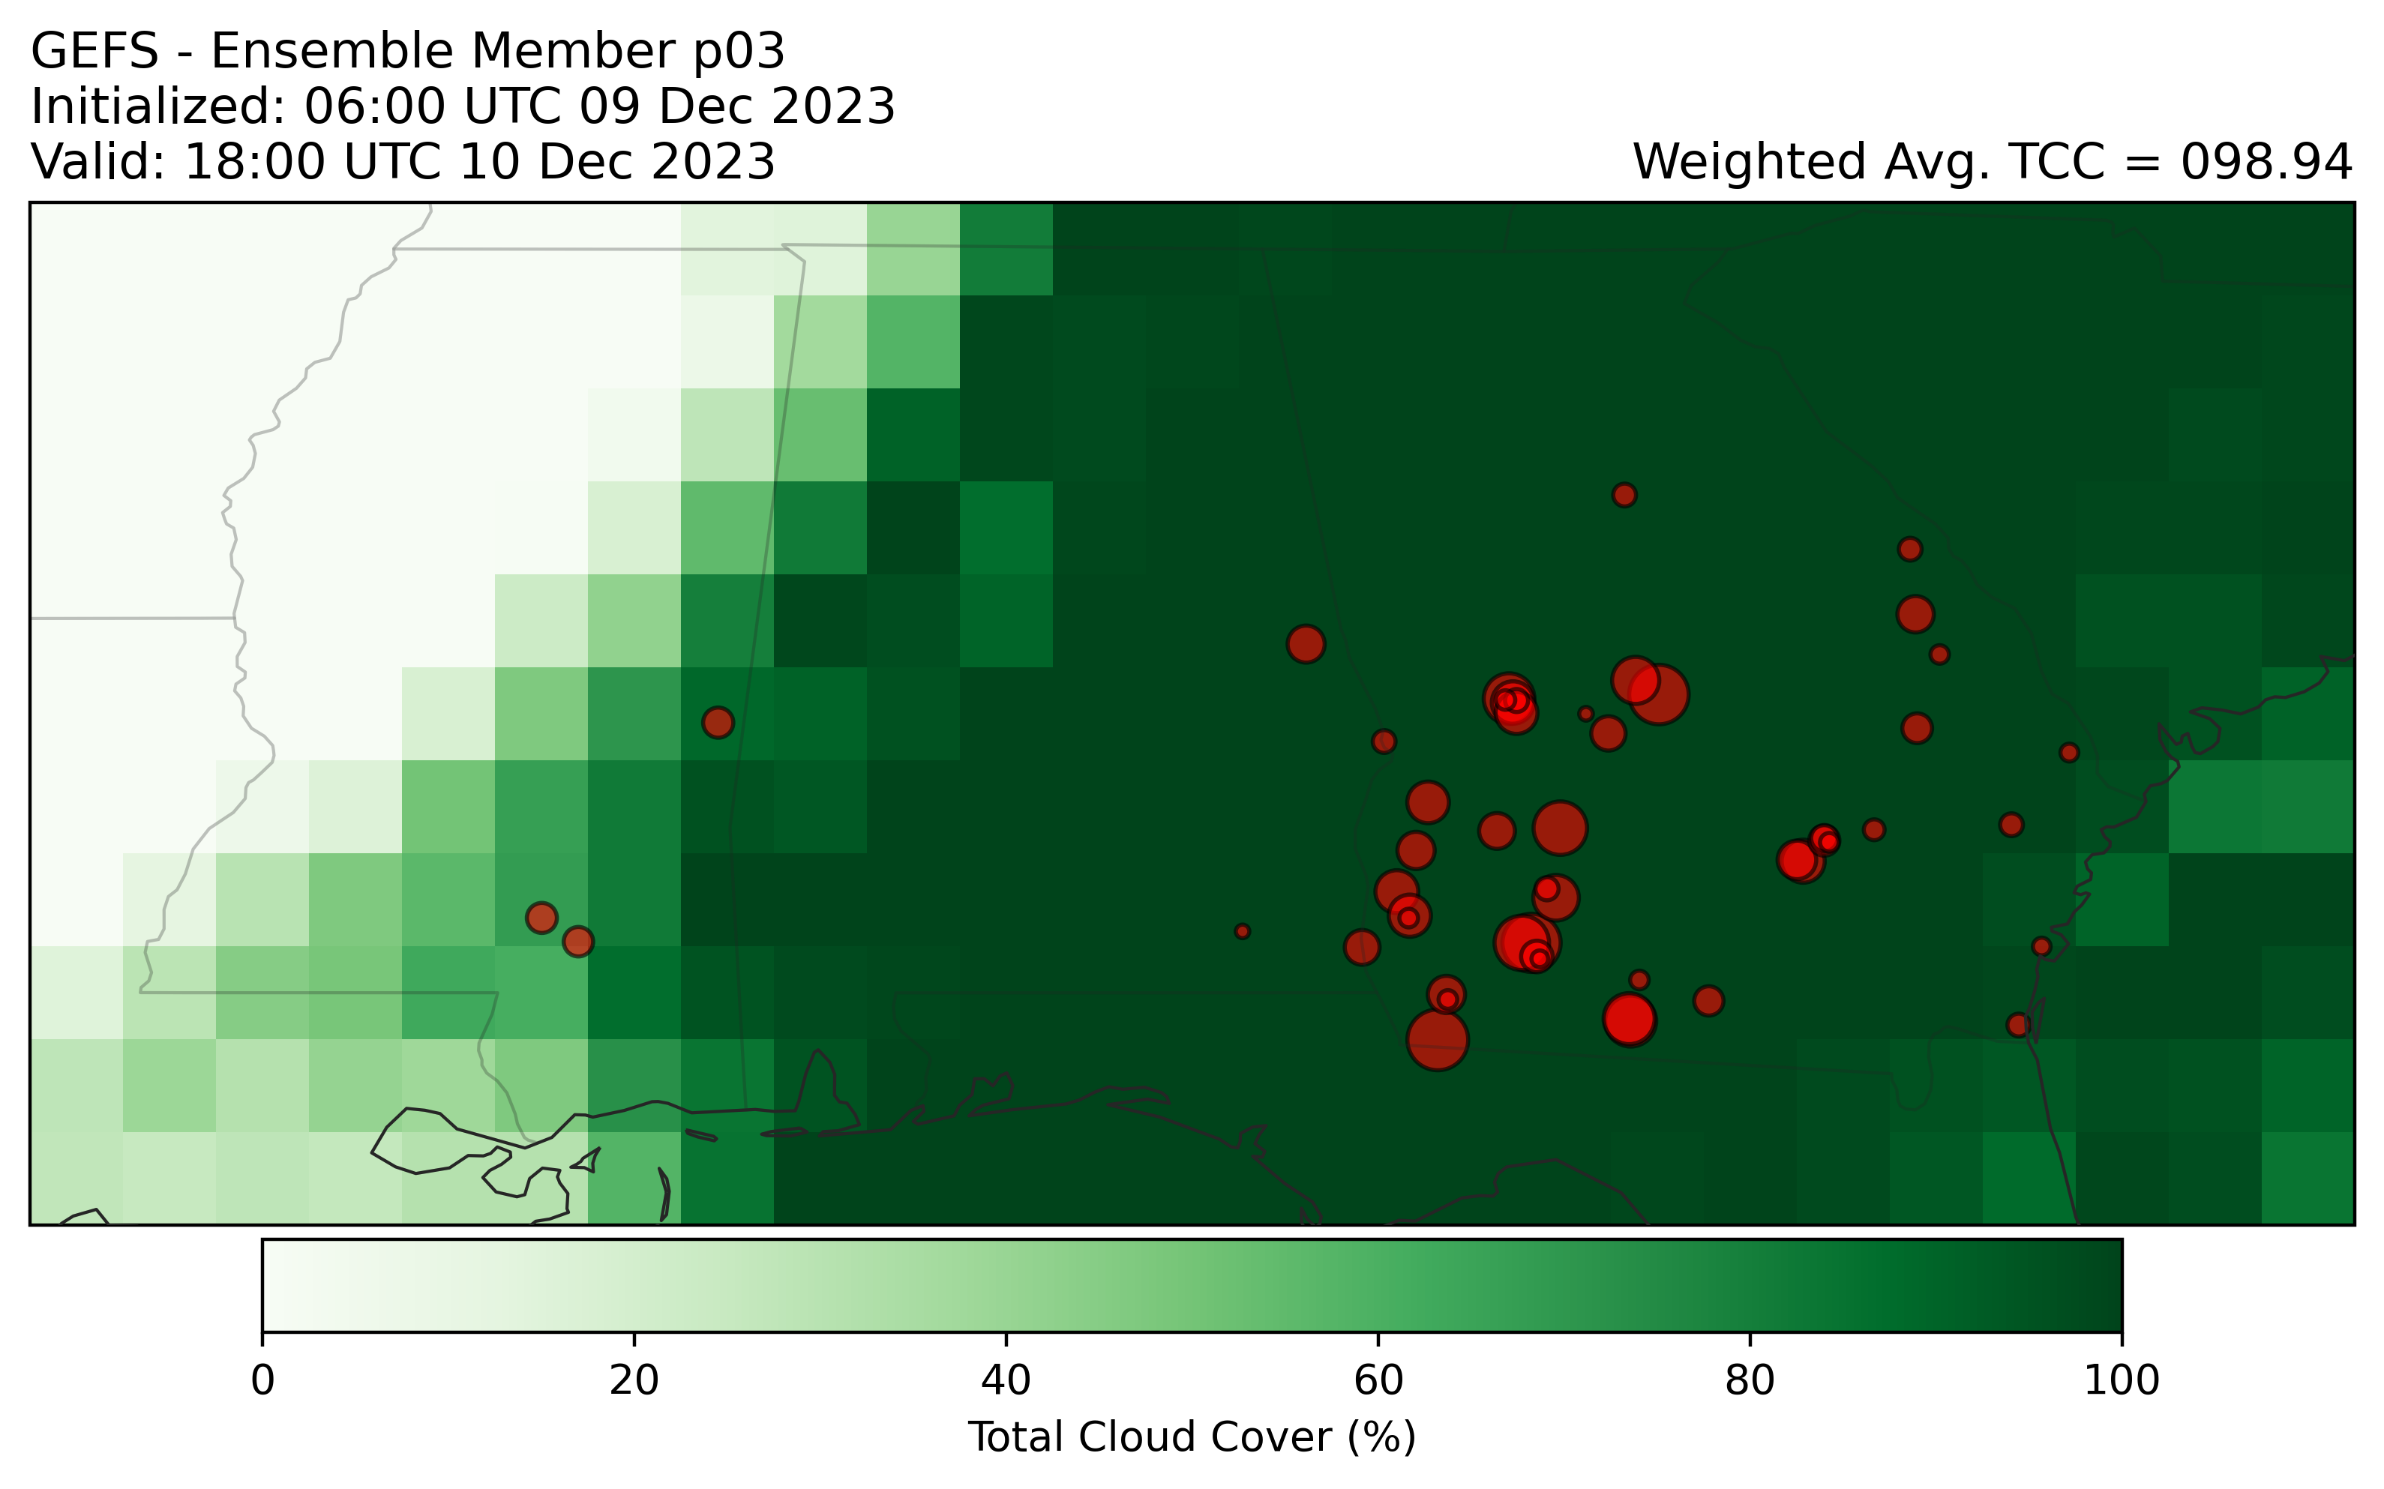

Slide 15
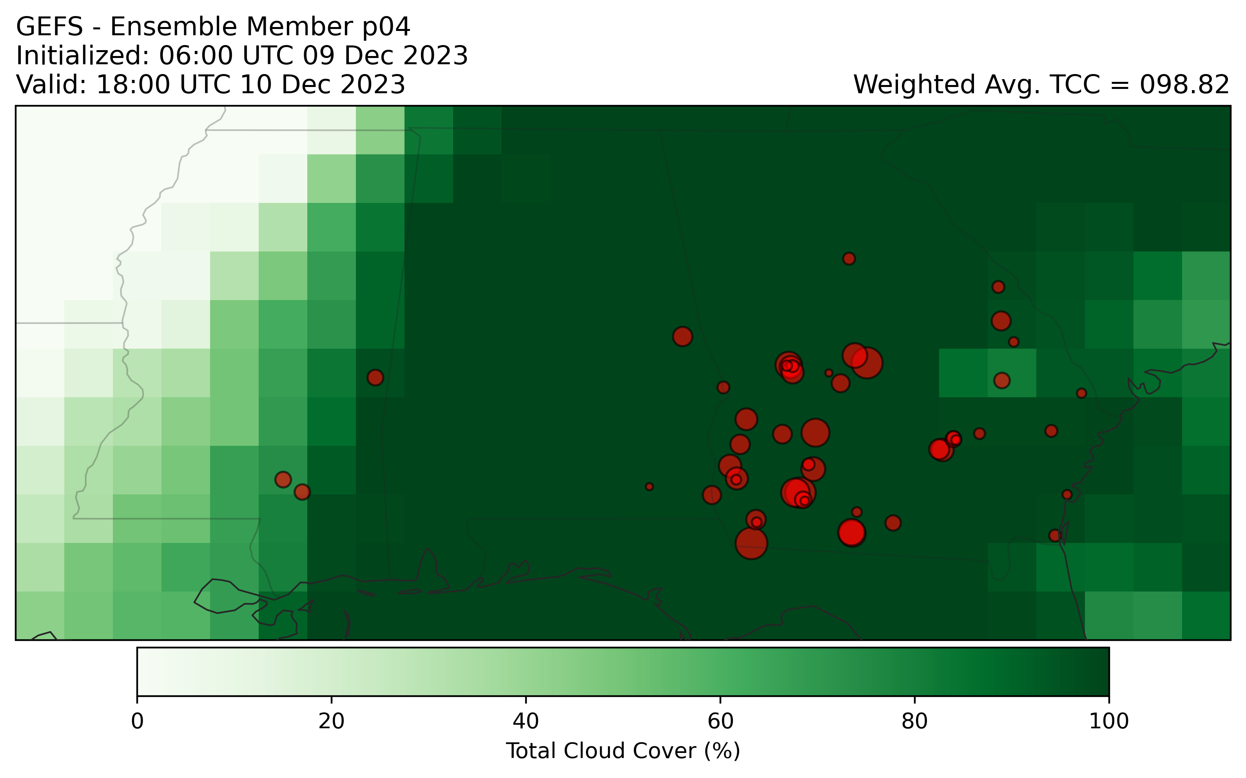

Slide 16
Real examples:
Low solar, high uncertainty day
(4 ensemble members shown, full analysis includes all 30 members)

Slide 17
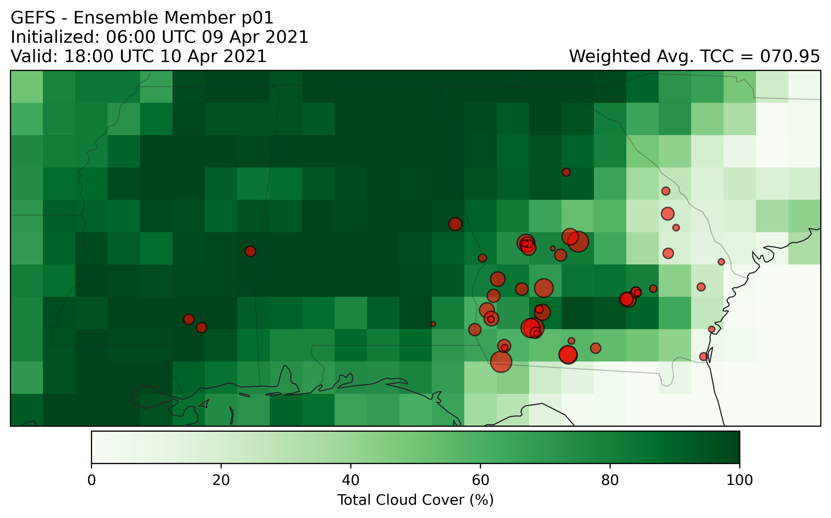

Slide 18
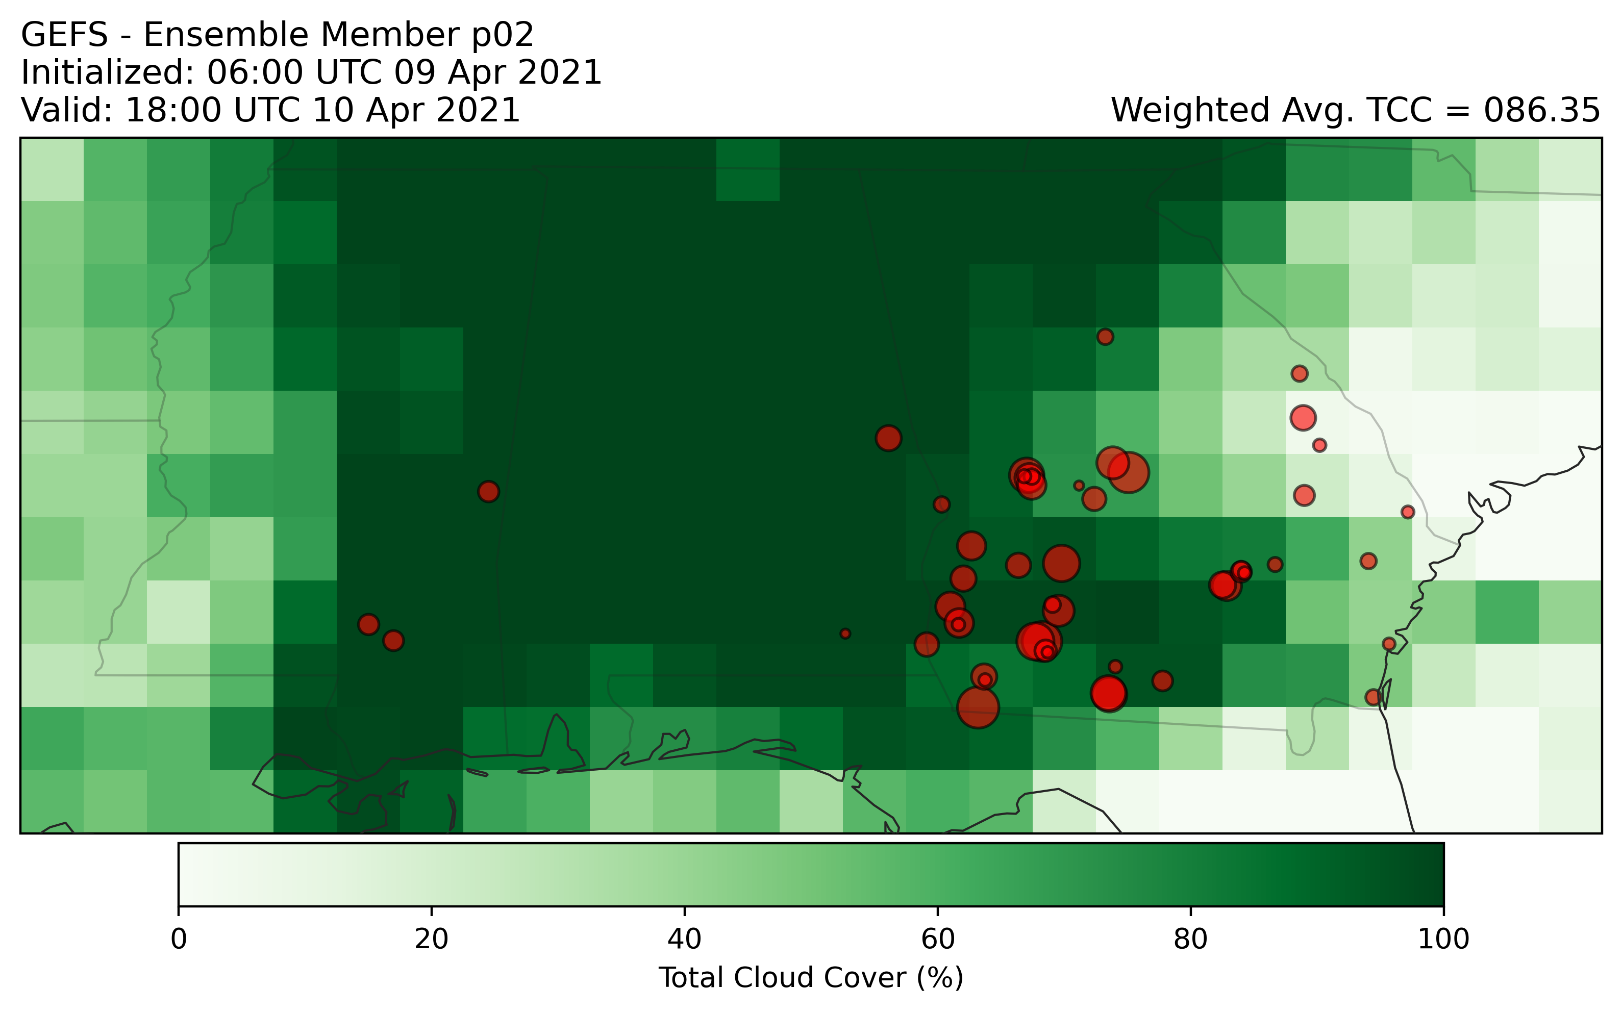

Slide 19
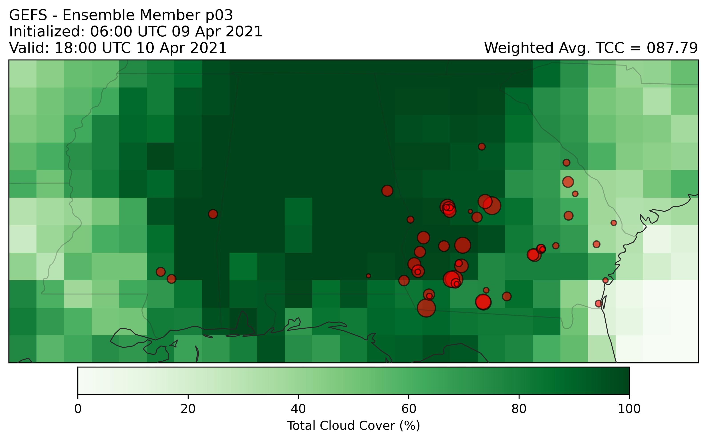

Slide 20
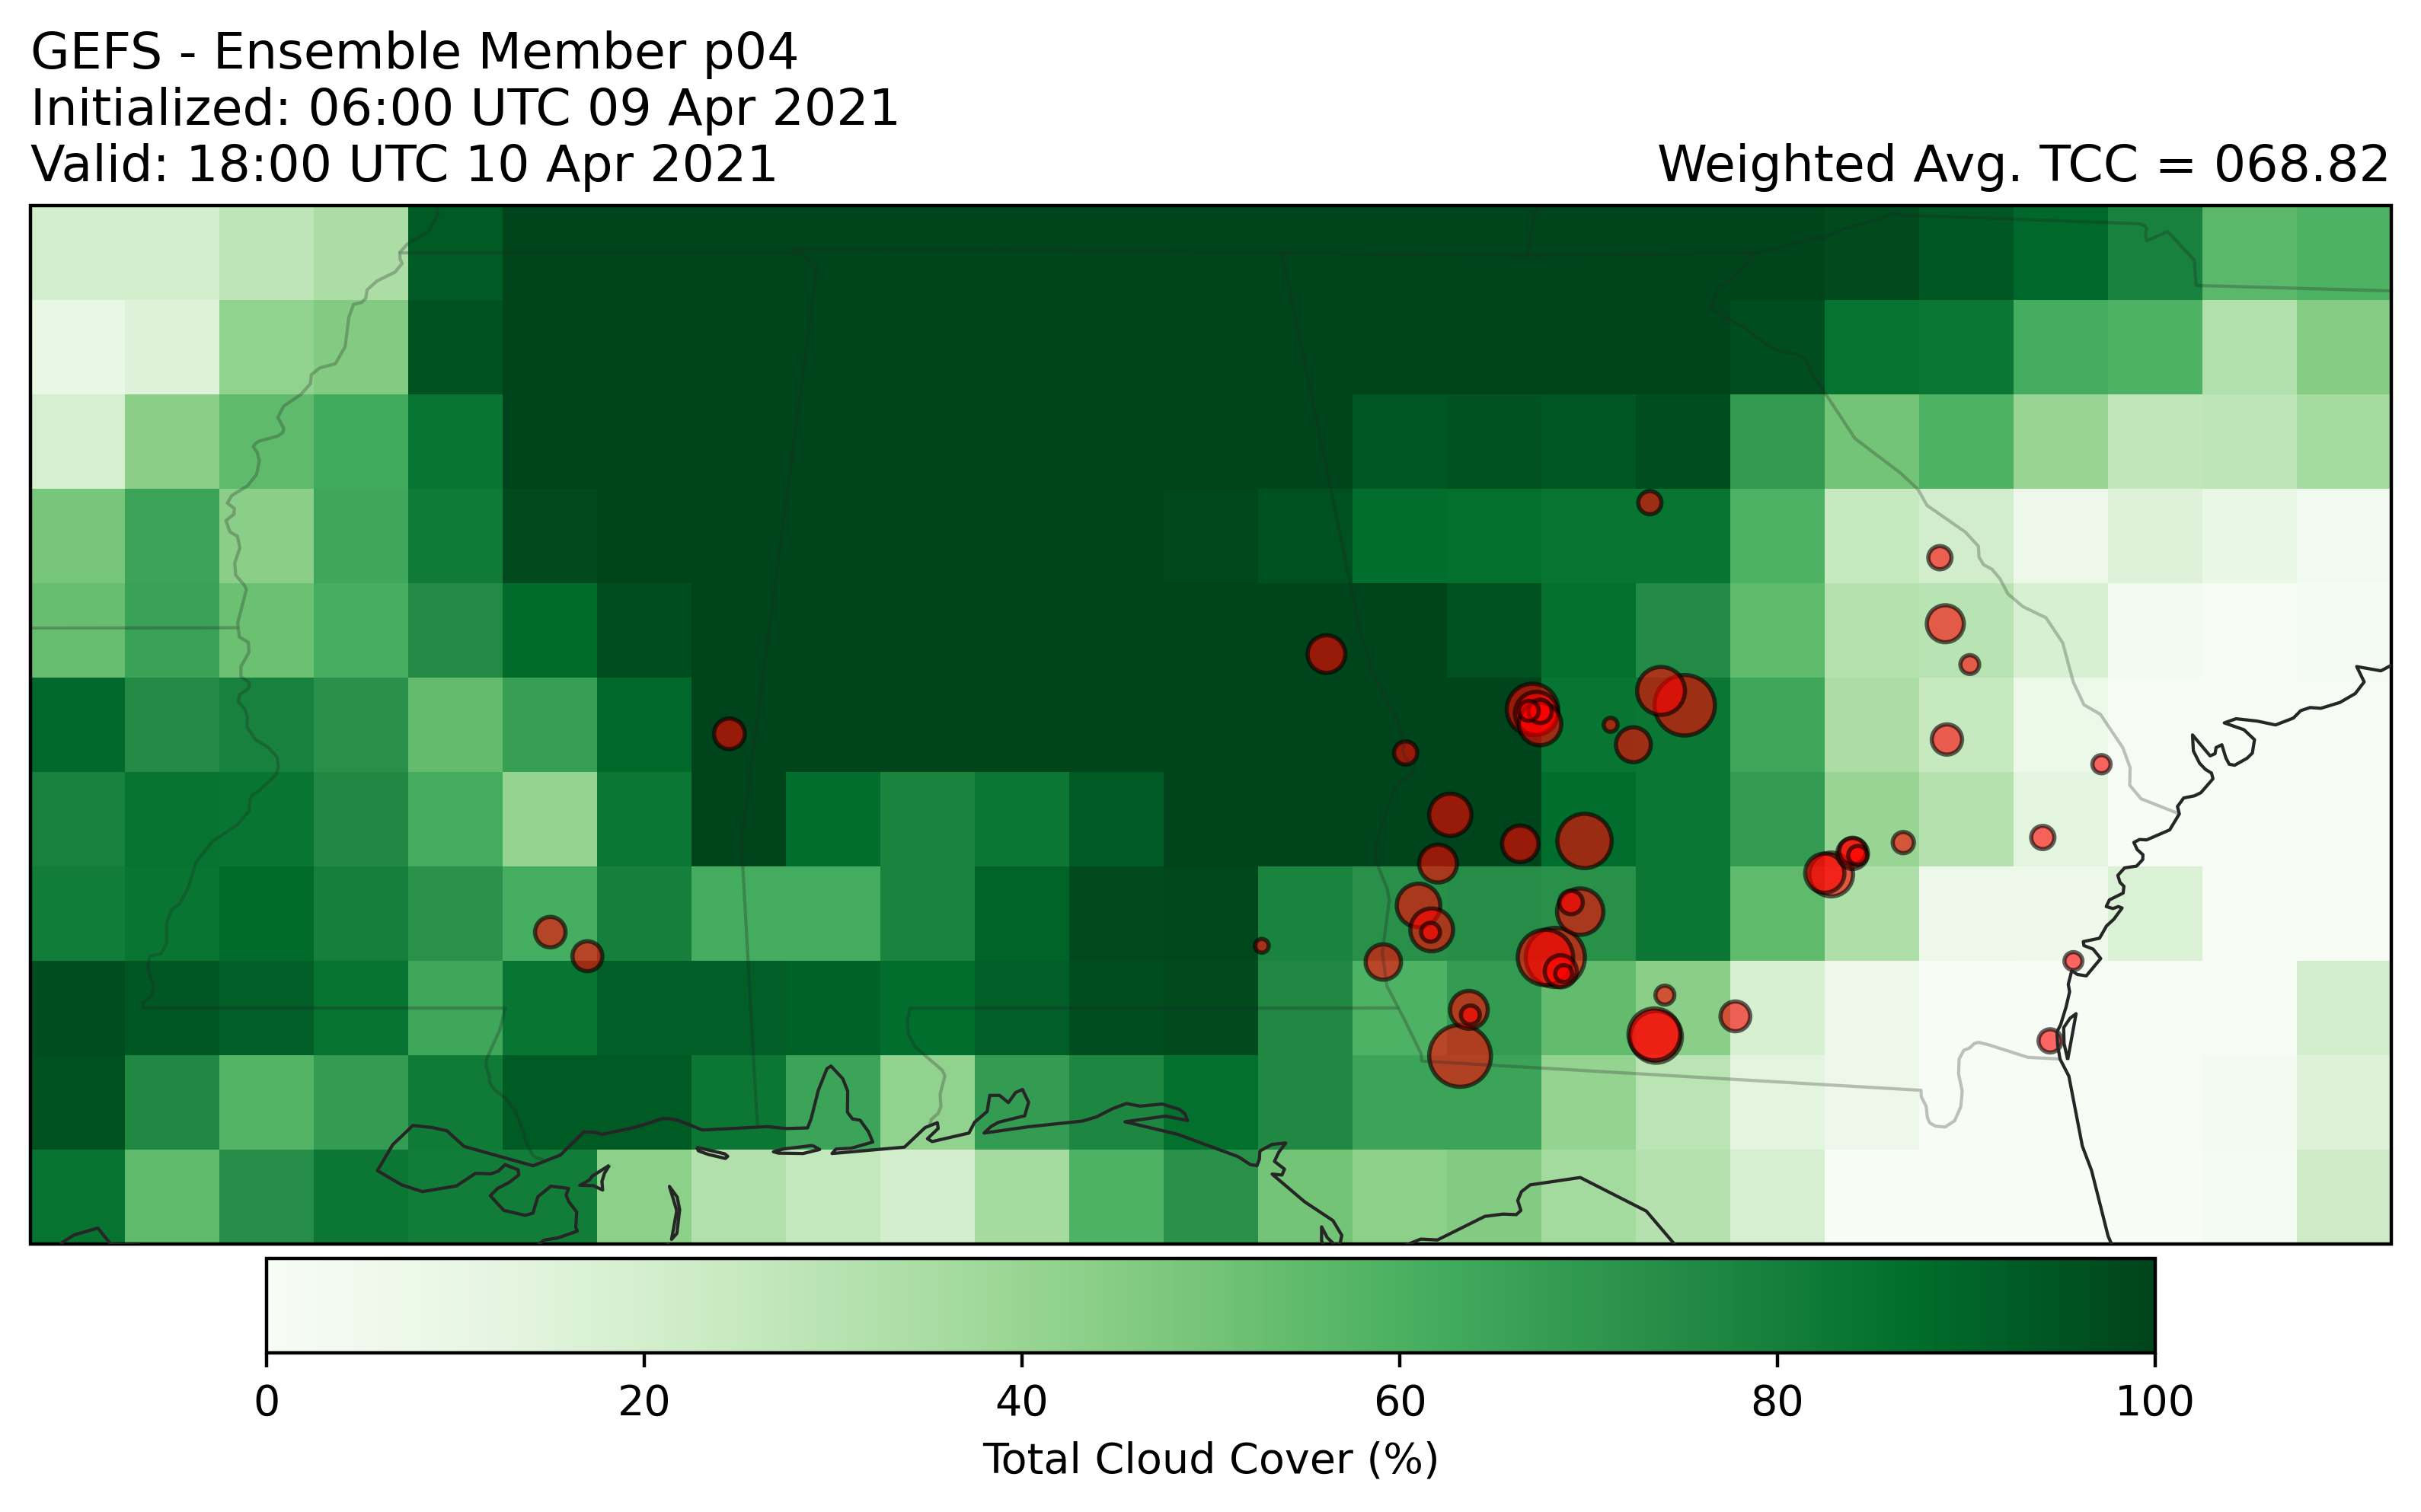

Slide 21
Real examples:
High solar, low uncertainty day
(4 ensemble members shown, full analysis includes all 30 members)

Slide 22
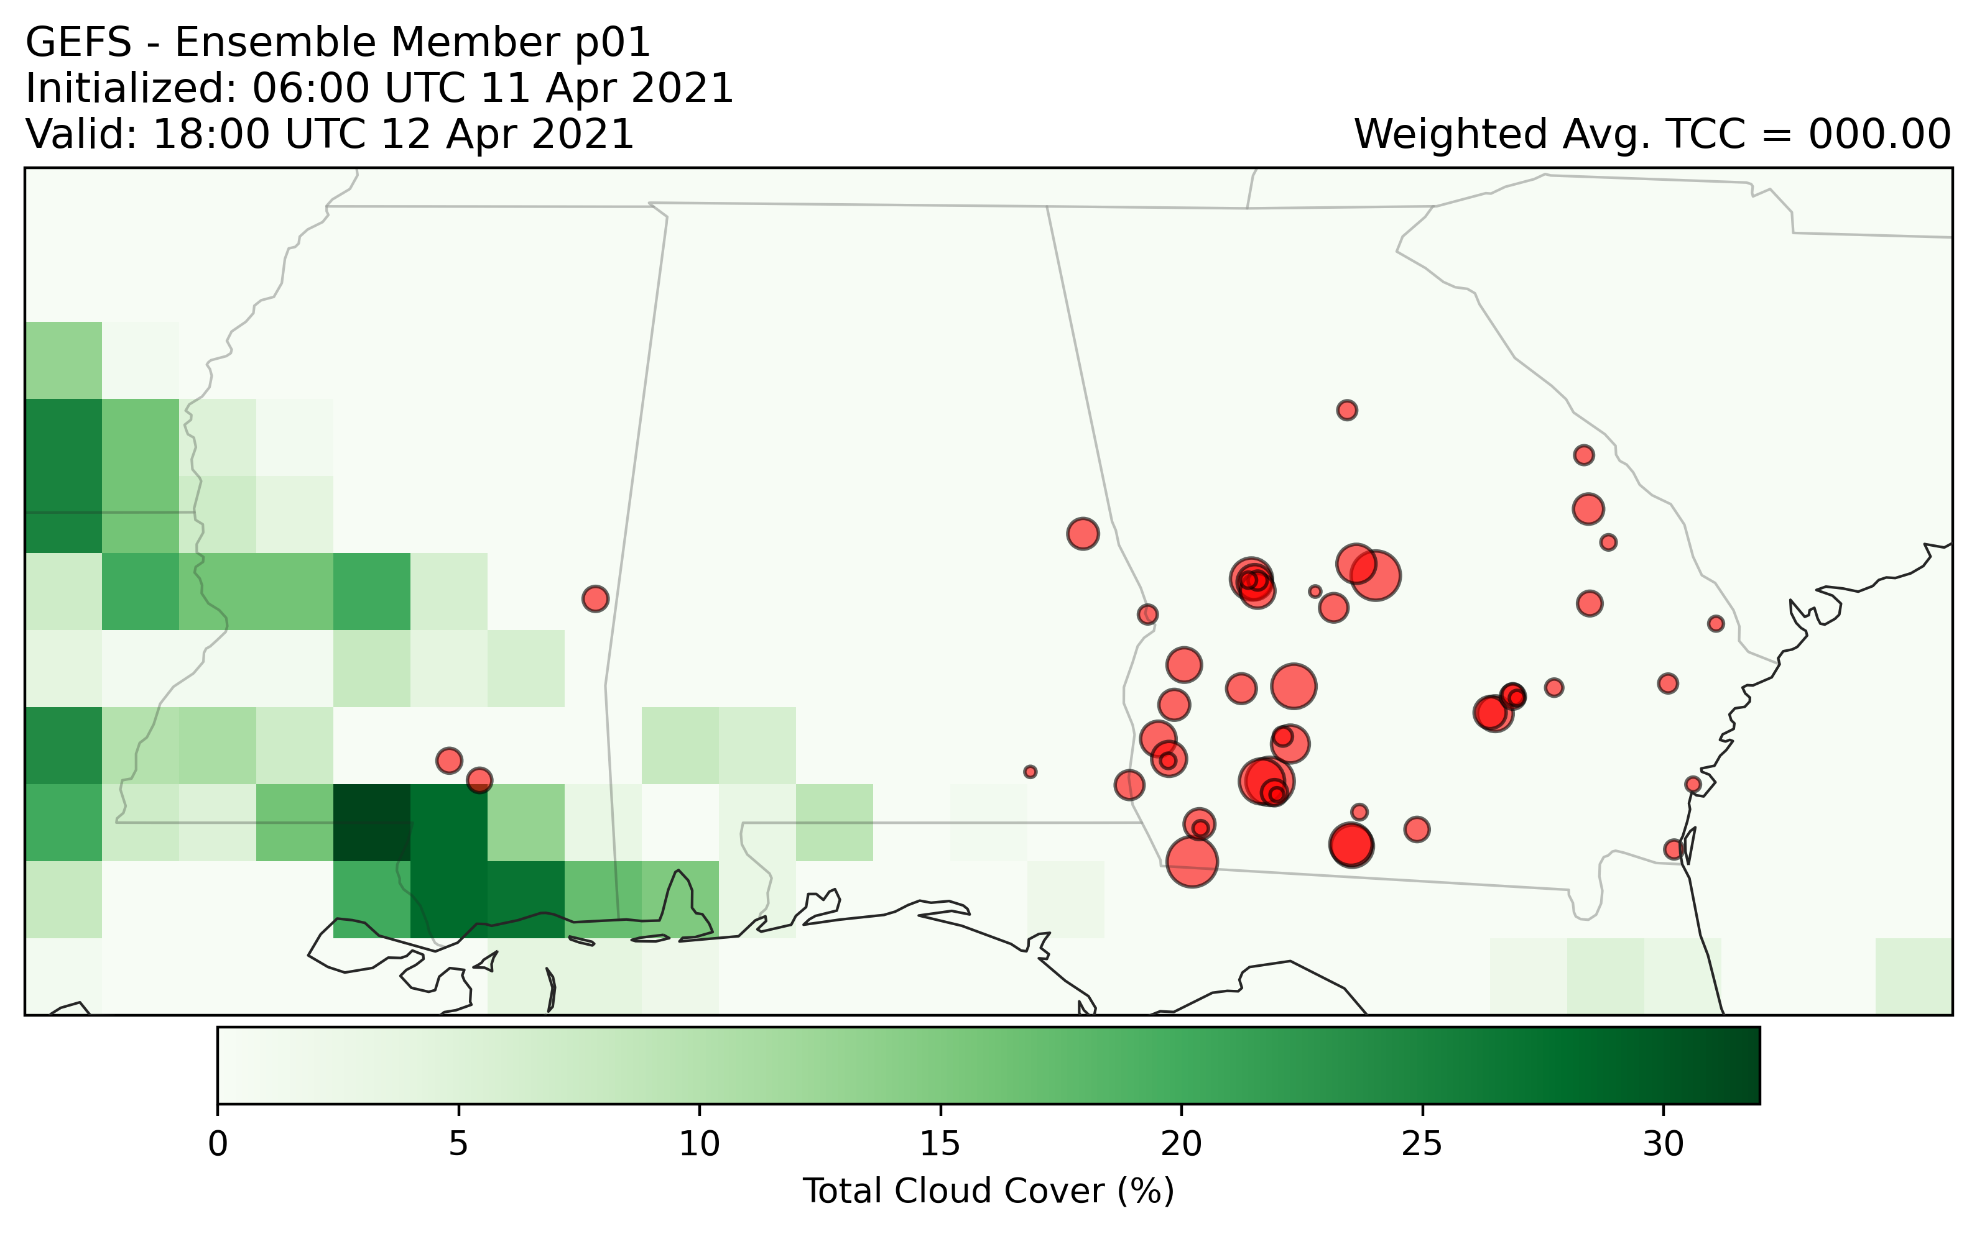

Slide 23
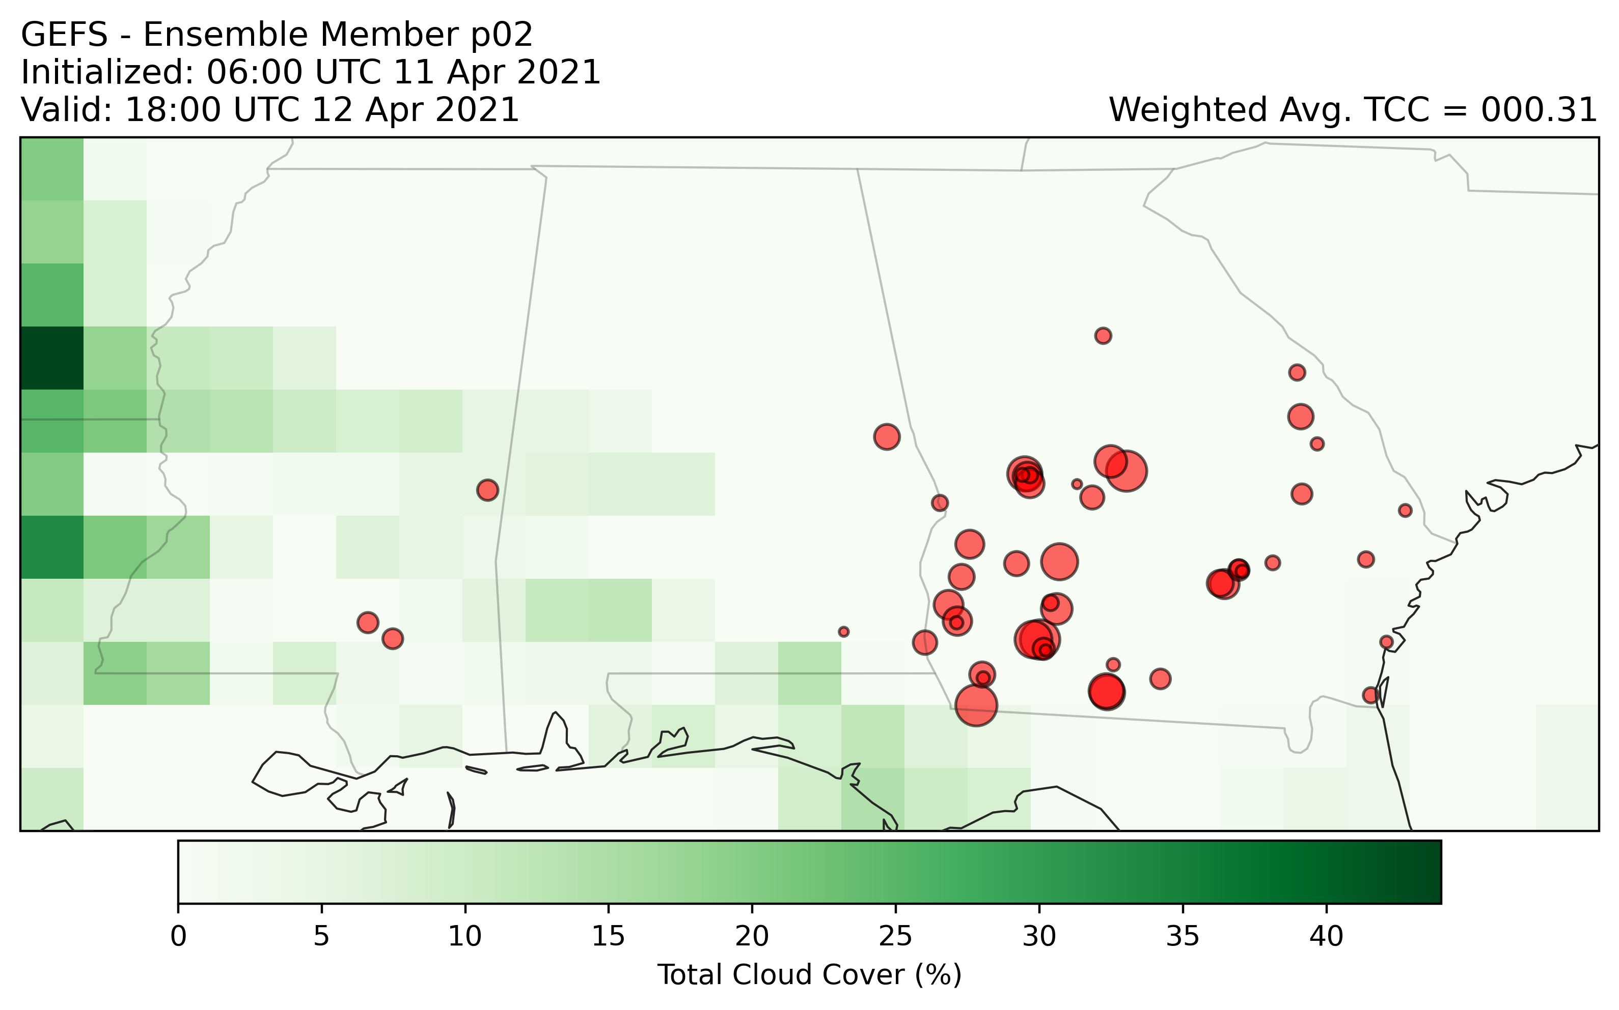

Slide 24
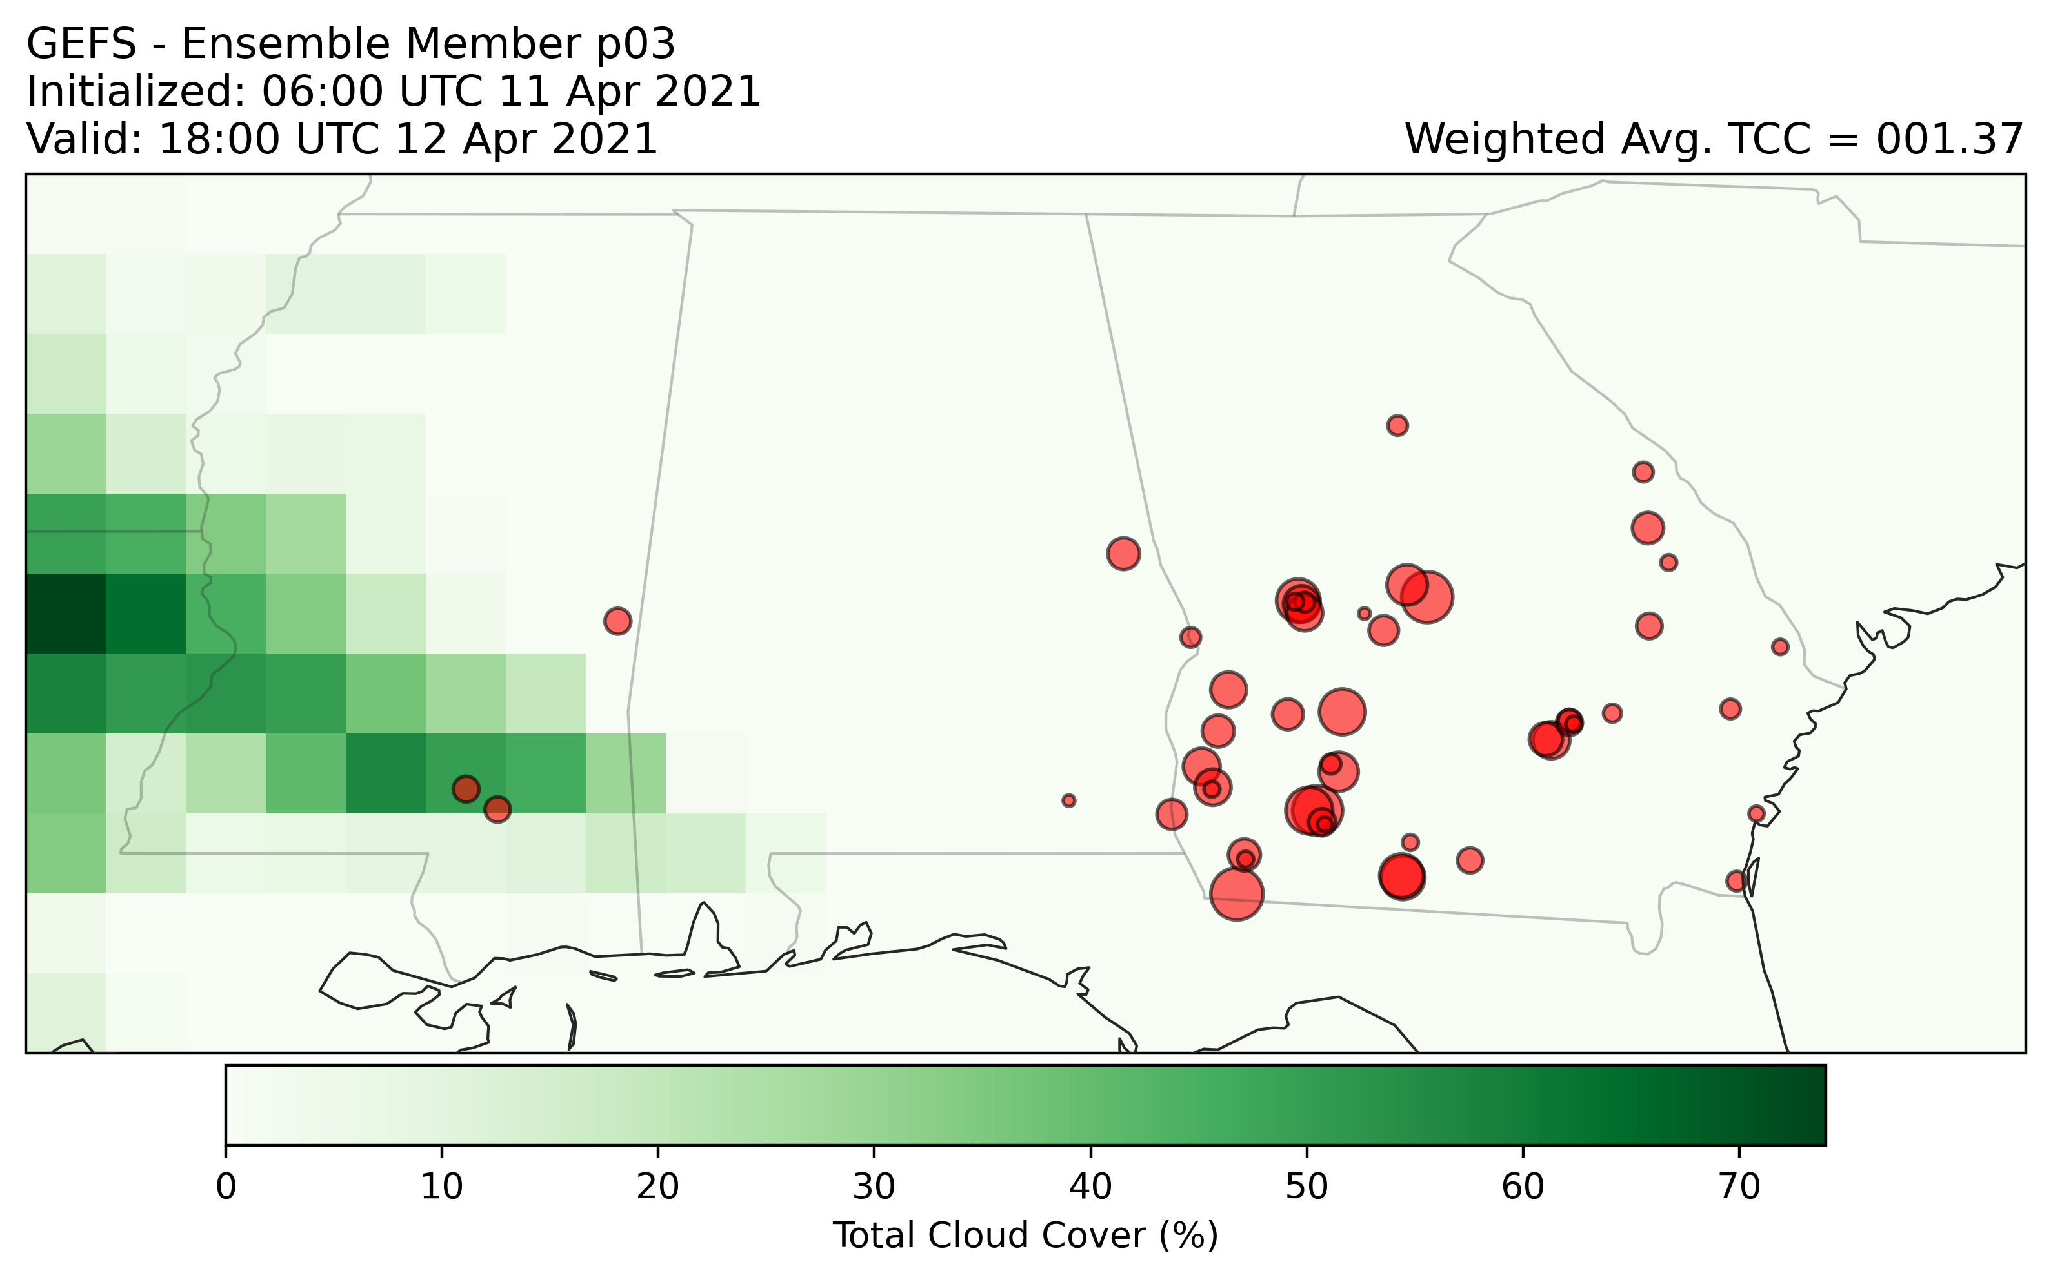

Slide 25
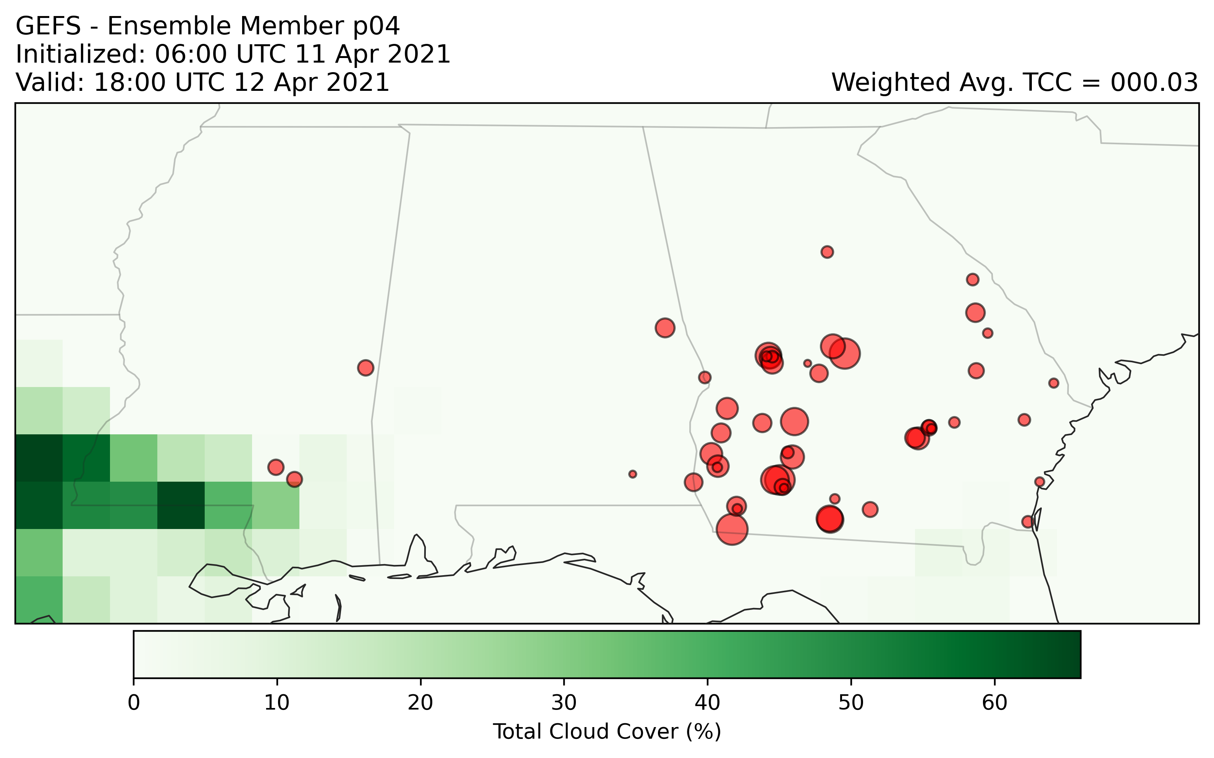

Slide 26
Spatial variation from HRRR
Use NOAA’s HRRR (high resolution rapid refresh) model

Slide 27
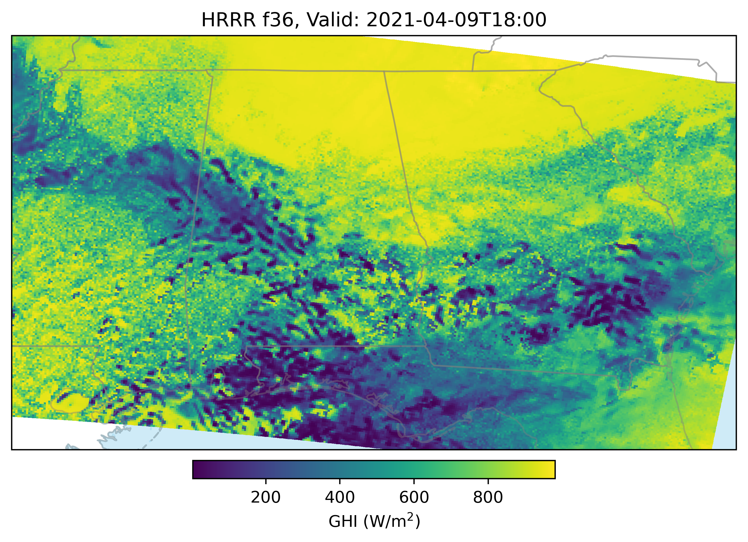

Slide 28


Slide 29
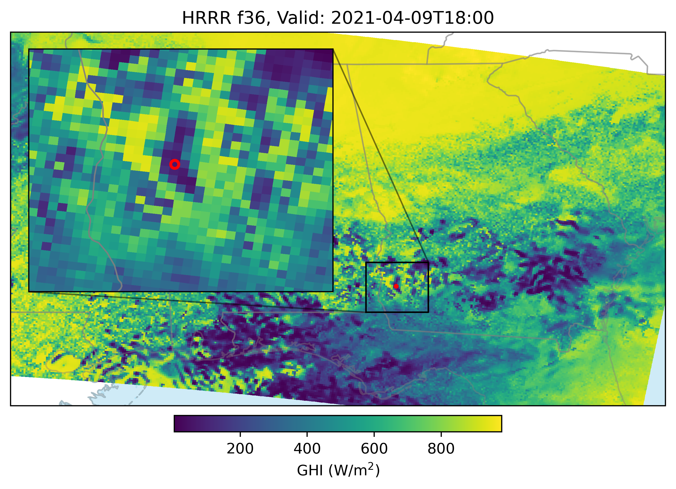

Slide 30


Slide 31
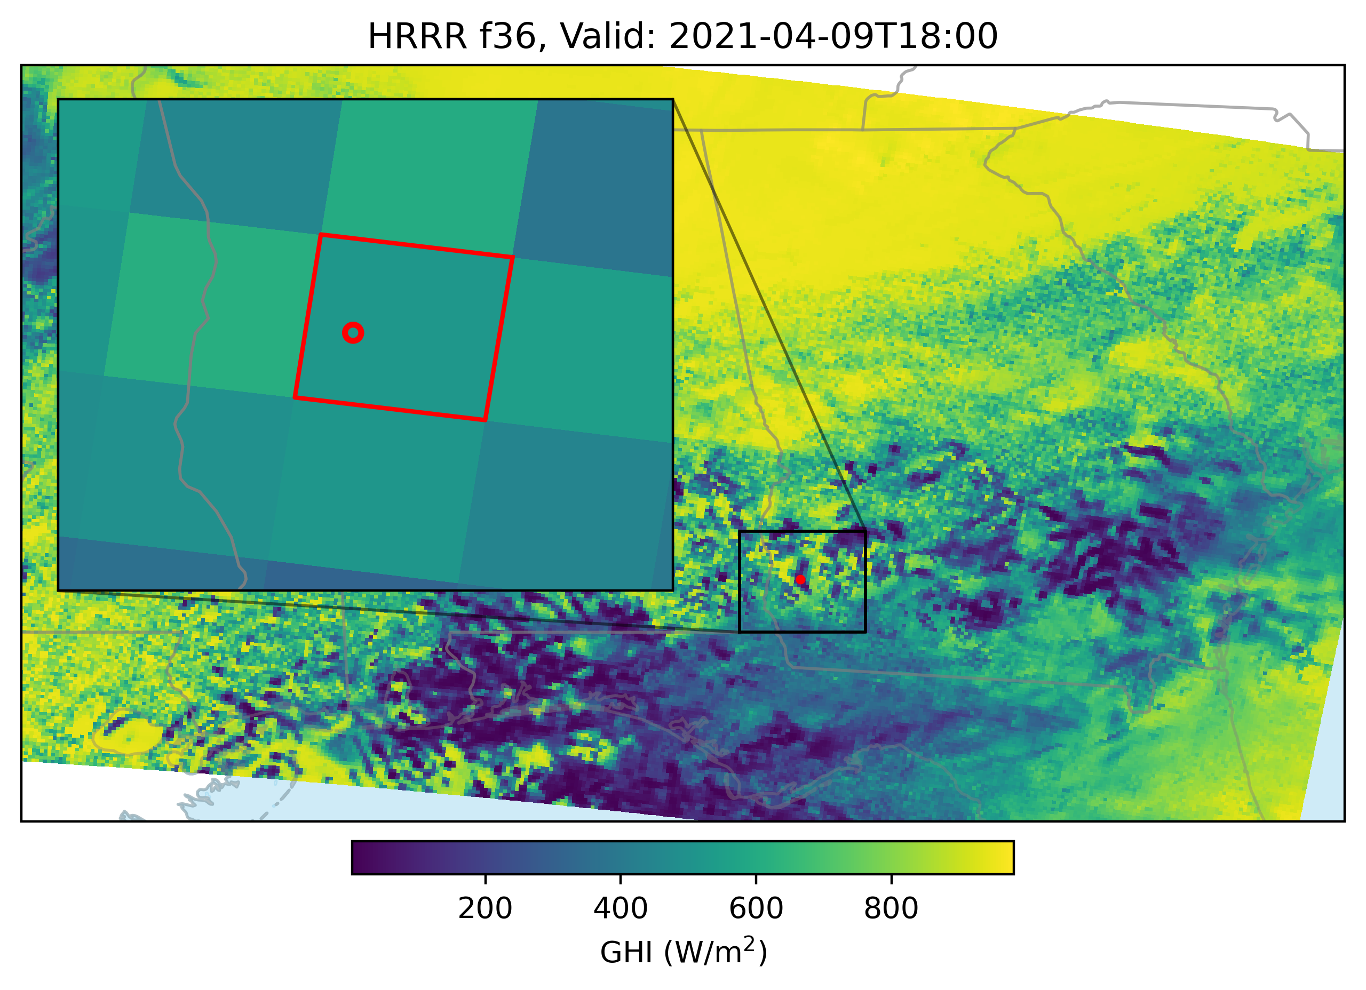

Slide 33


Max
Min
…model power, repeat for all plants, sum mins, sum maxes

Slide 34
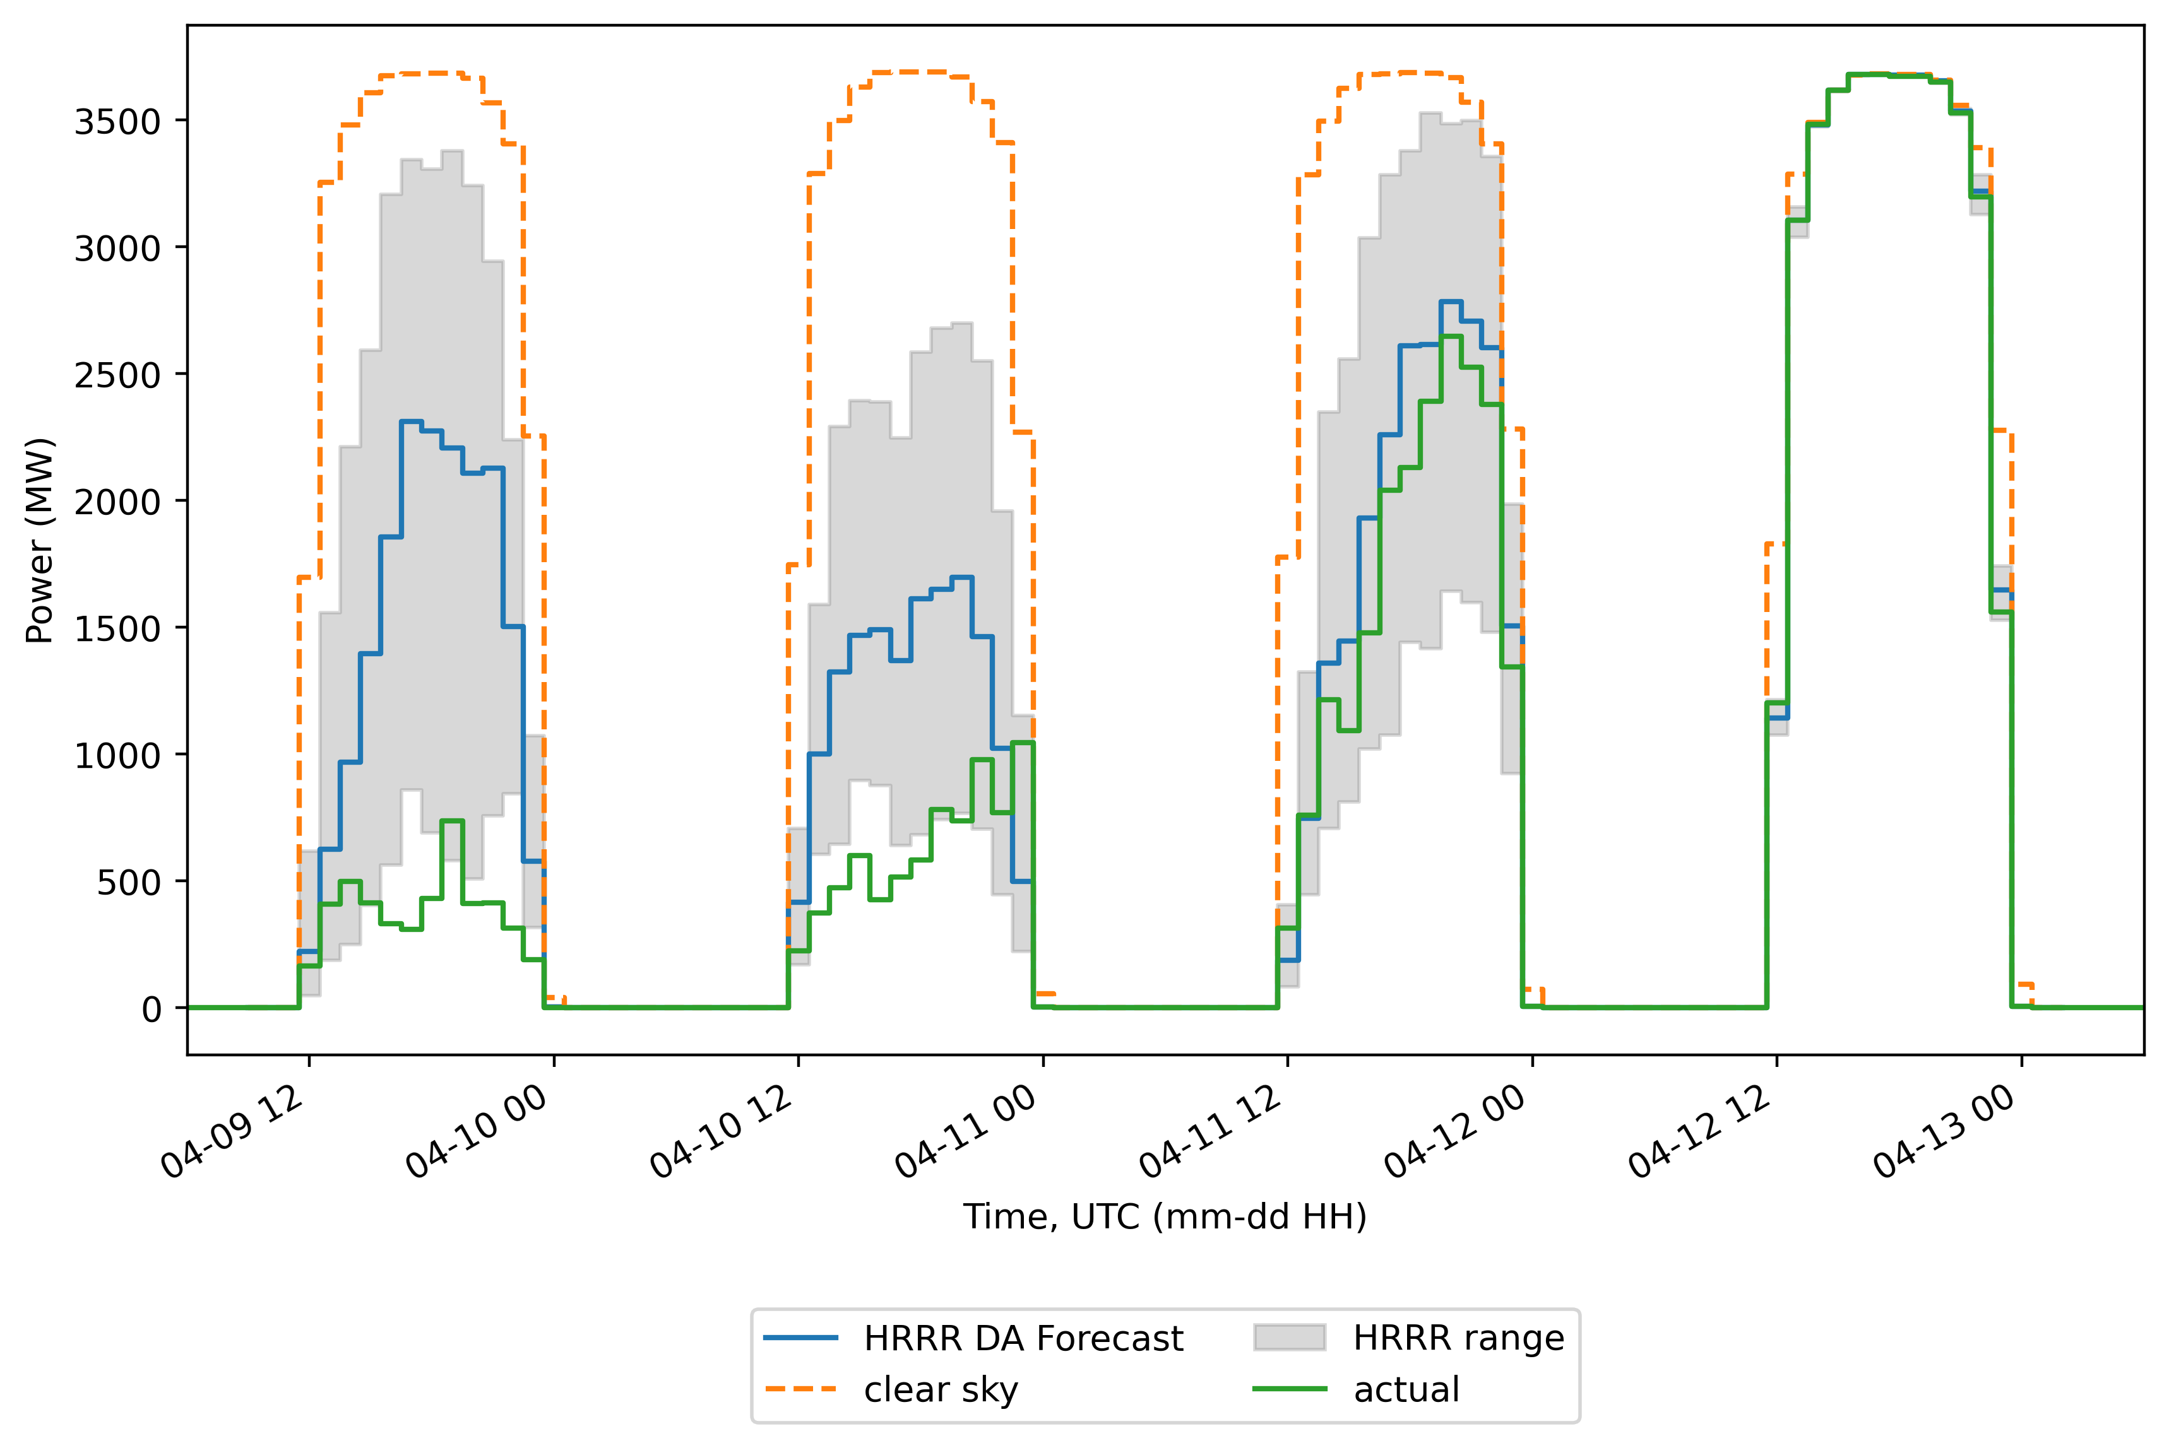



Example results:
High uncertainty
Medium uncertainty
Low uncertainty

Slide 35
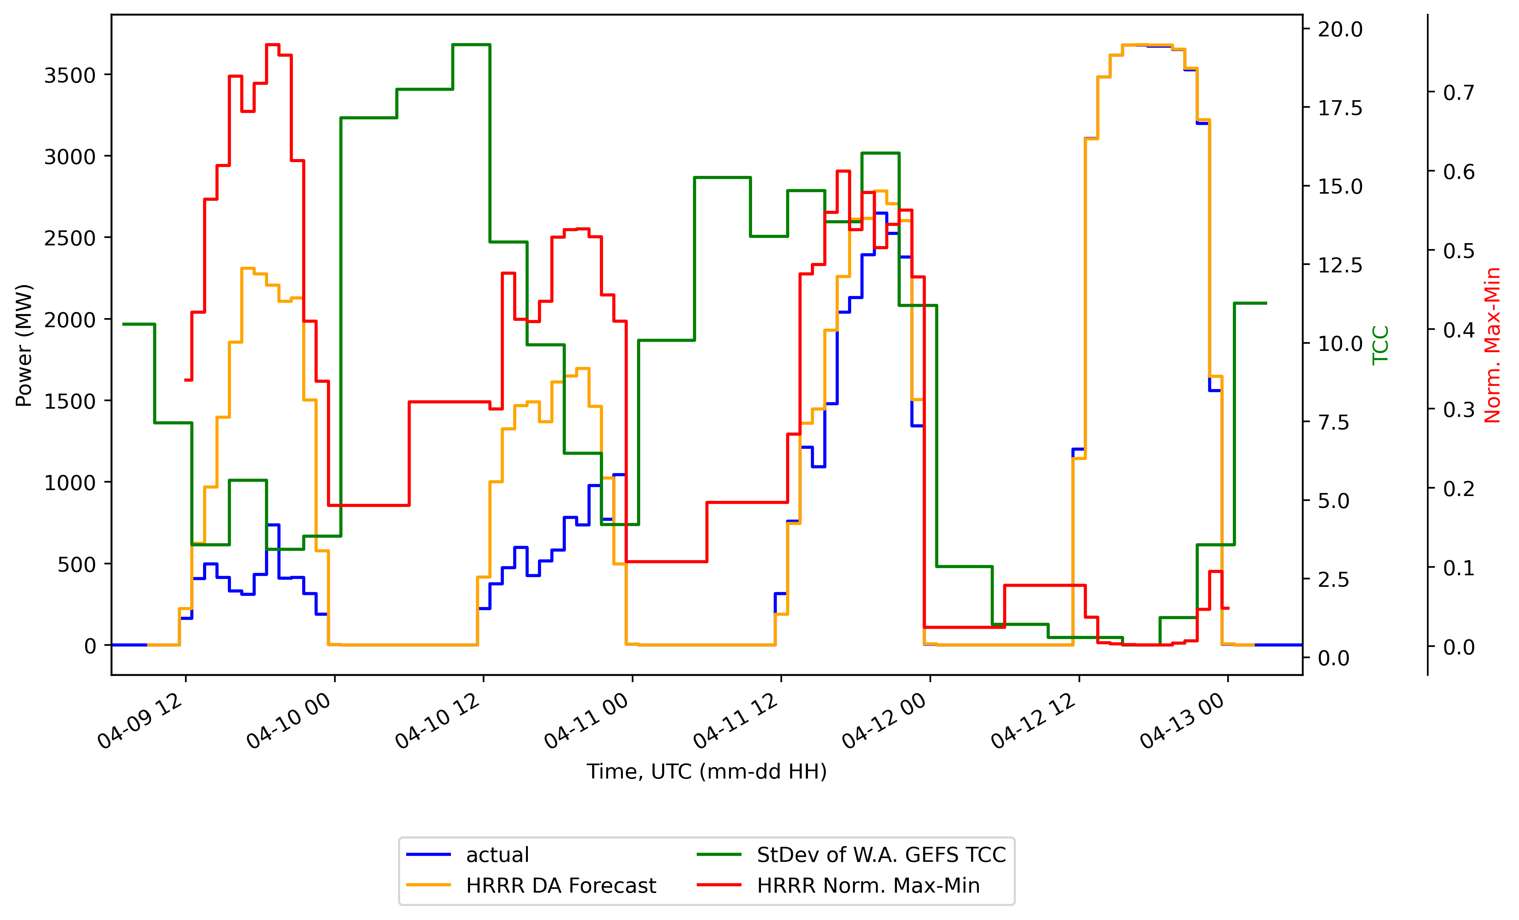
TCC and spatial variation for the days we’ve been looking at:

Slide 36
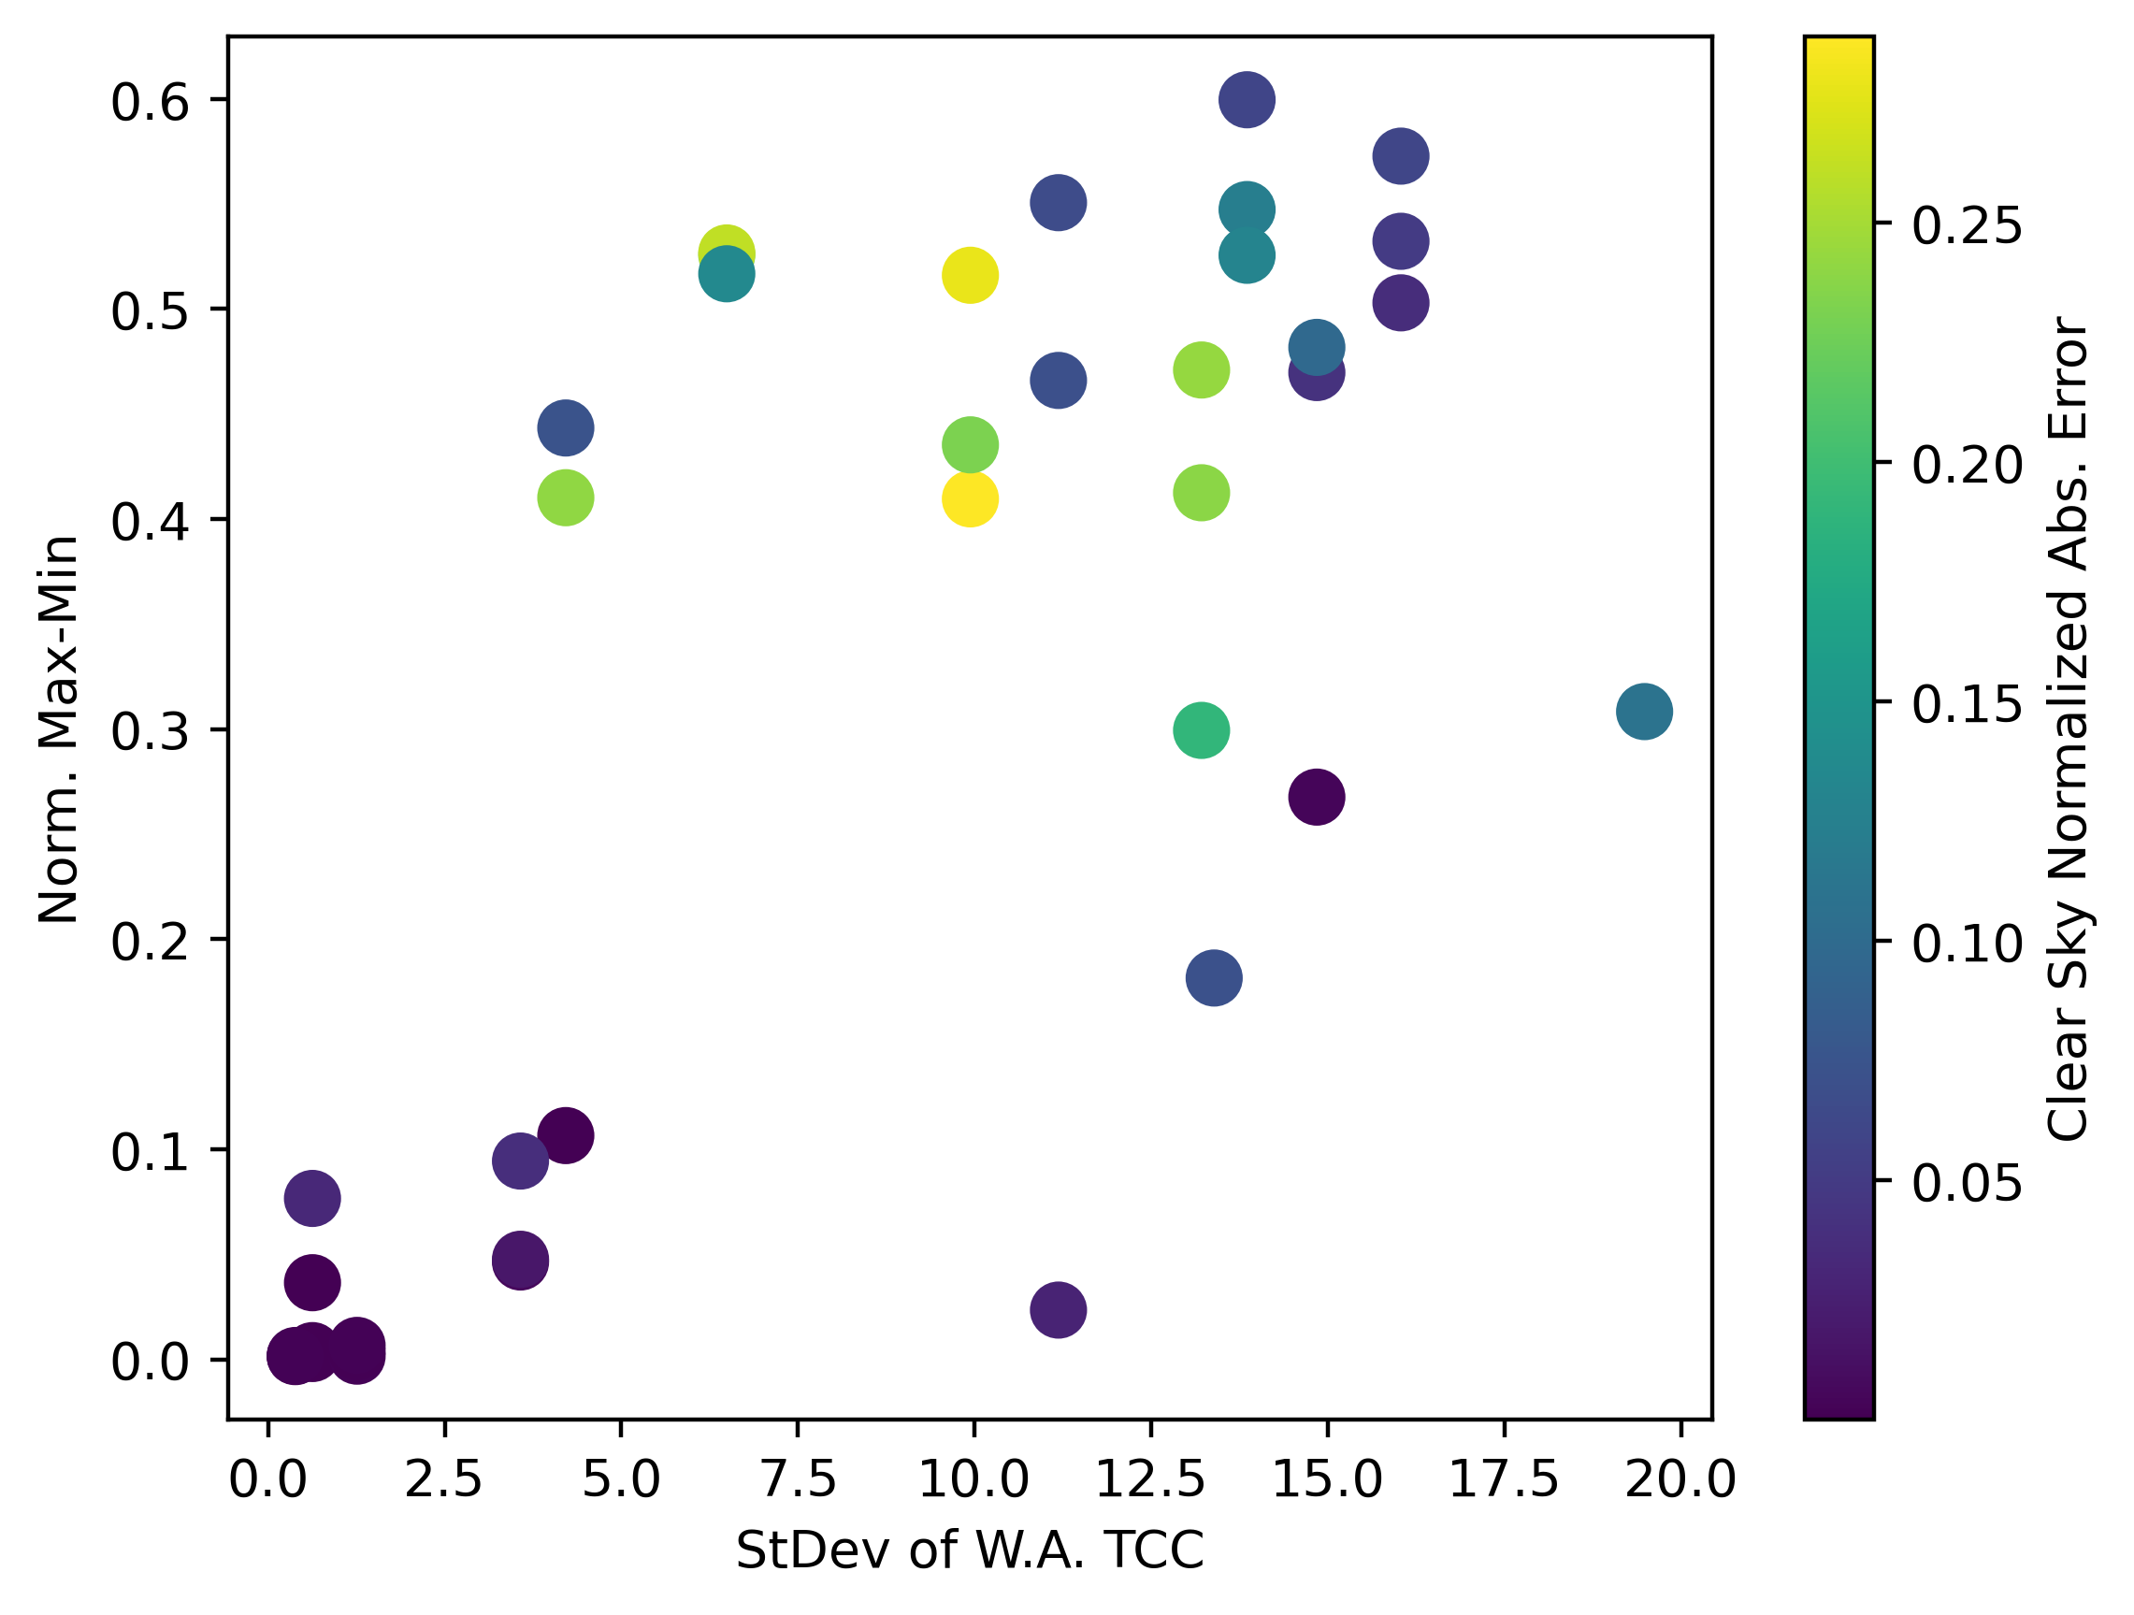


…now in a scatter plot:

Slide 37
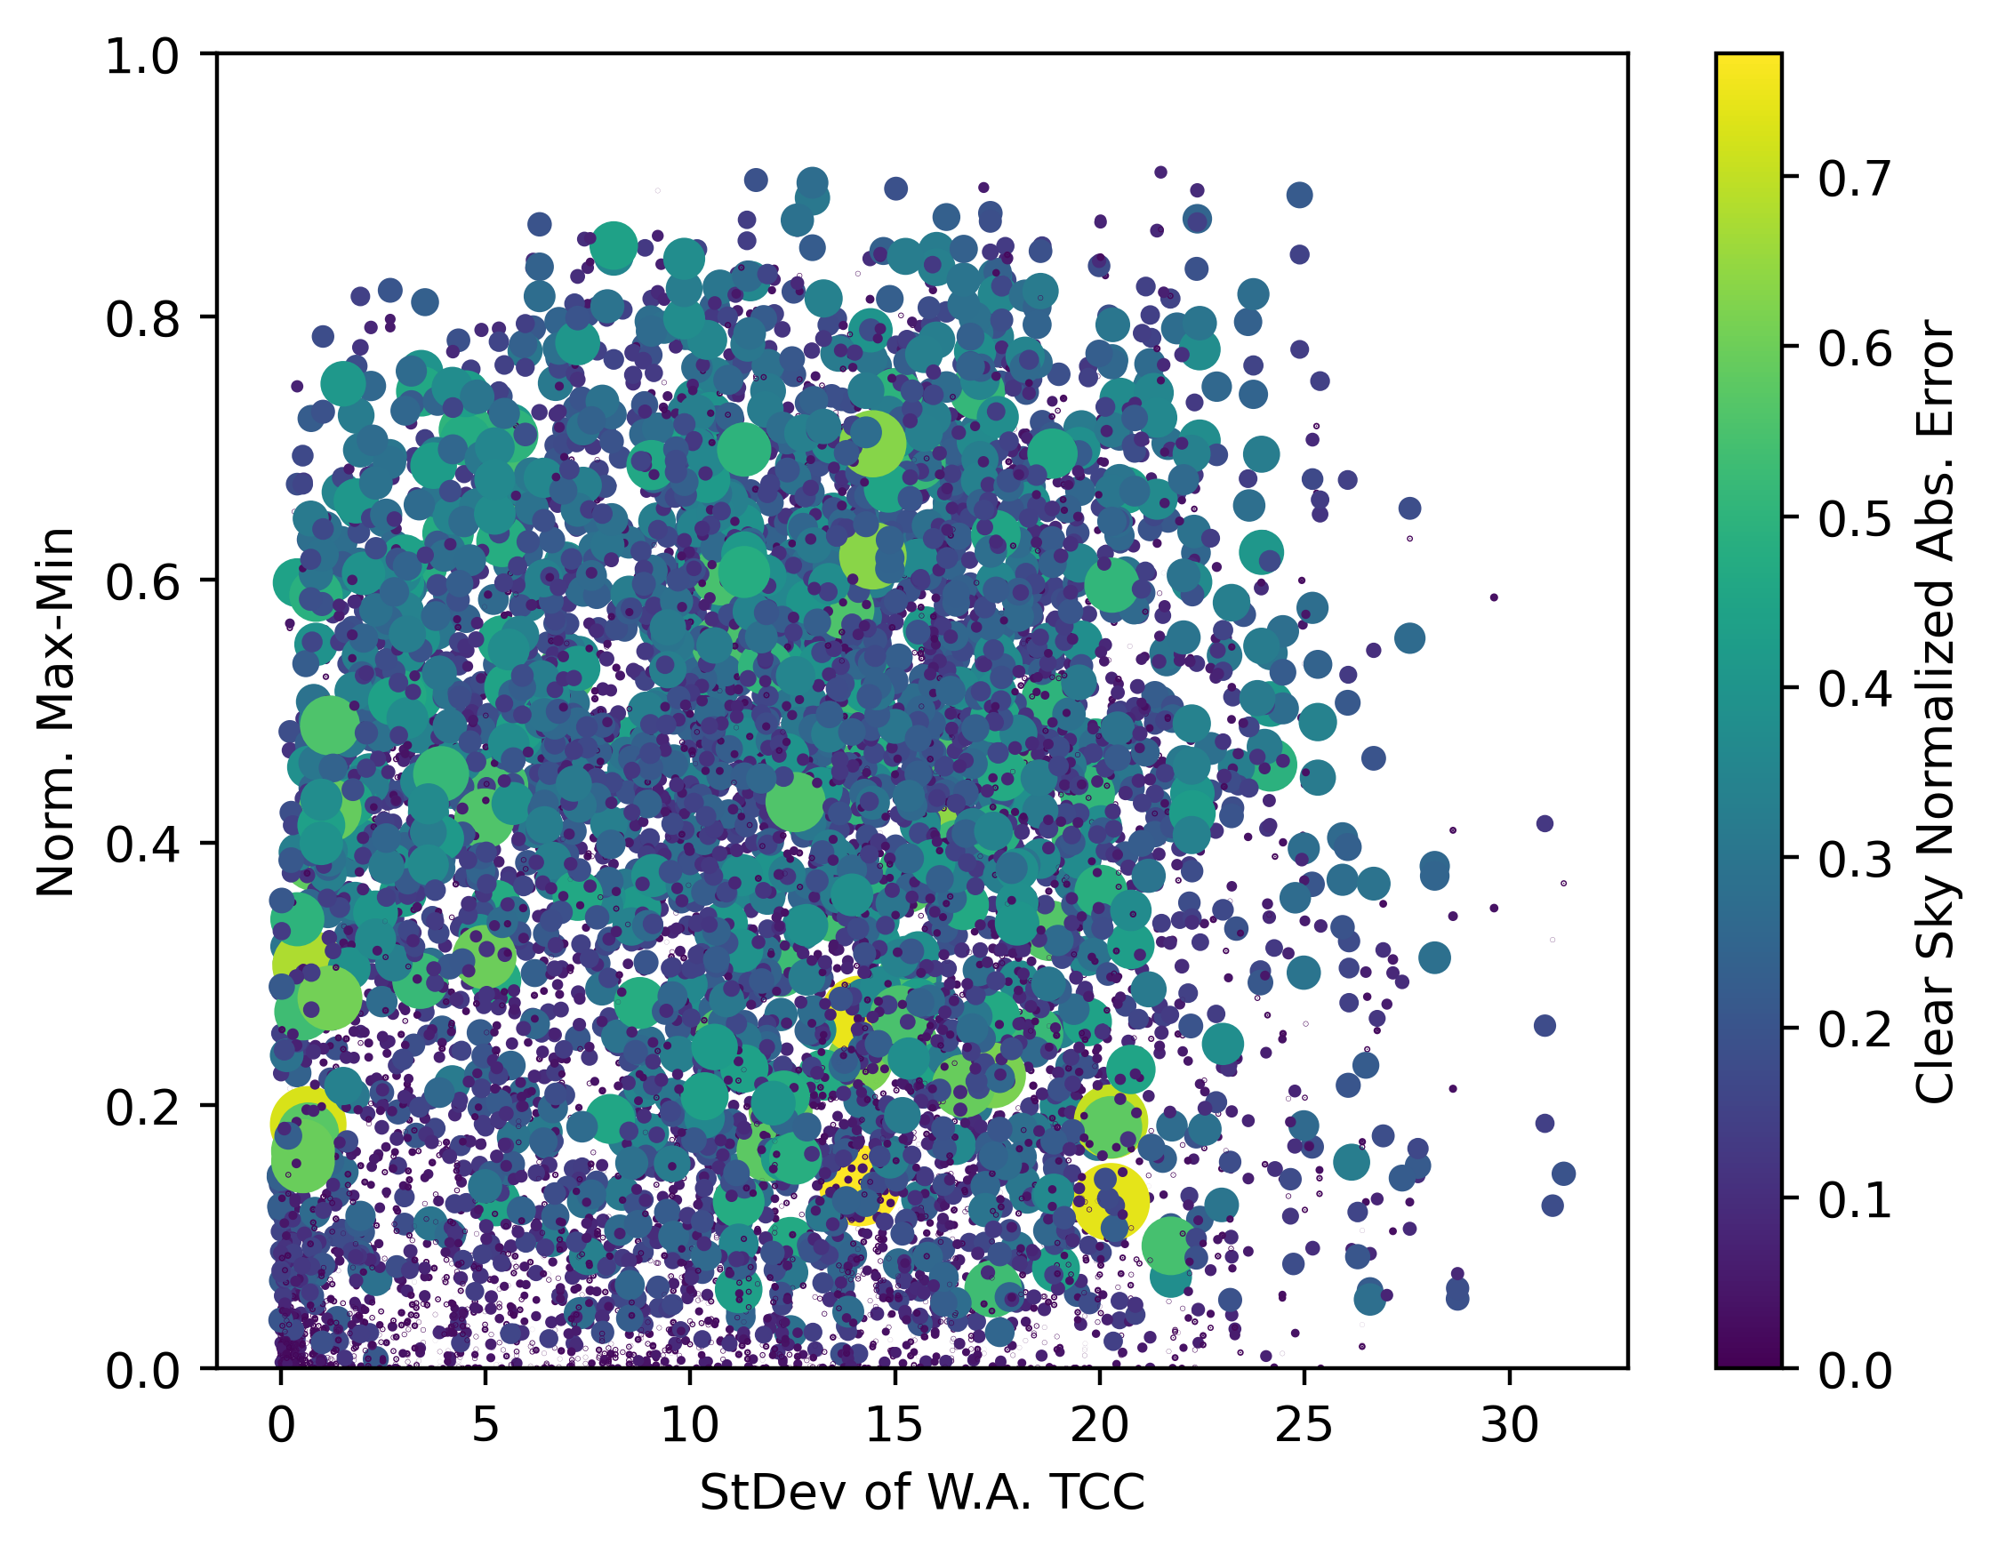
… and for 2 full years:
My conclusion: There’s something there, but it’s not a clear relationship

Slide 38
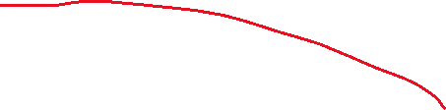
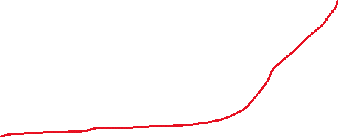

Solution:
Machine learning quantile regression models: Random Forest, XGBoost
Inputs:
Existing forecast (normalized)
Historical forecast error (normalized)
Std. of TCC
HRRR “spread”
Position of the sun in the sky
Month of year
Output:
Updated forecast at different “quantiles”
Train with 2021/2022
Test with 2023

Slide 39
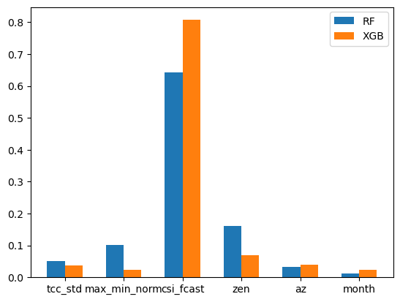
Feature importance
Novel indicators
Solar position
Deterministic forecast

Slide 40
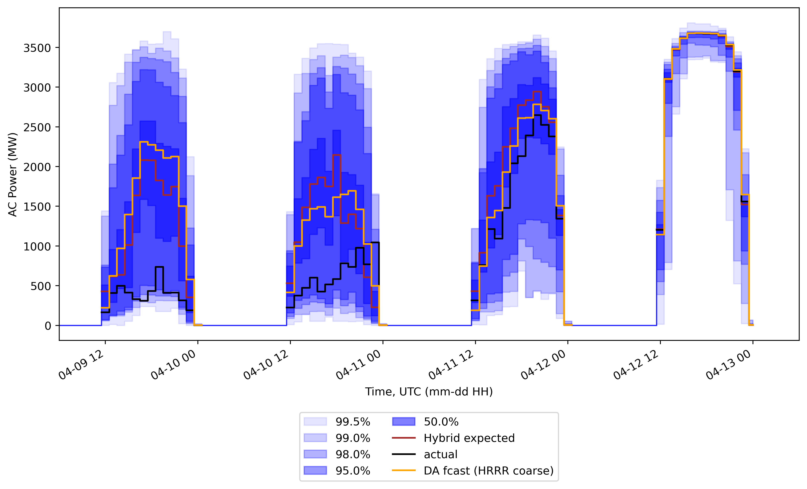
Sample results

Slide 41
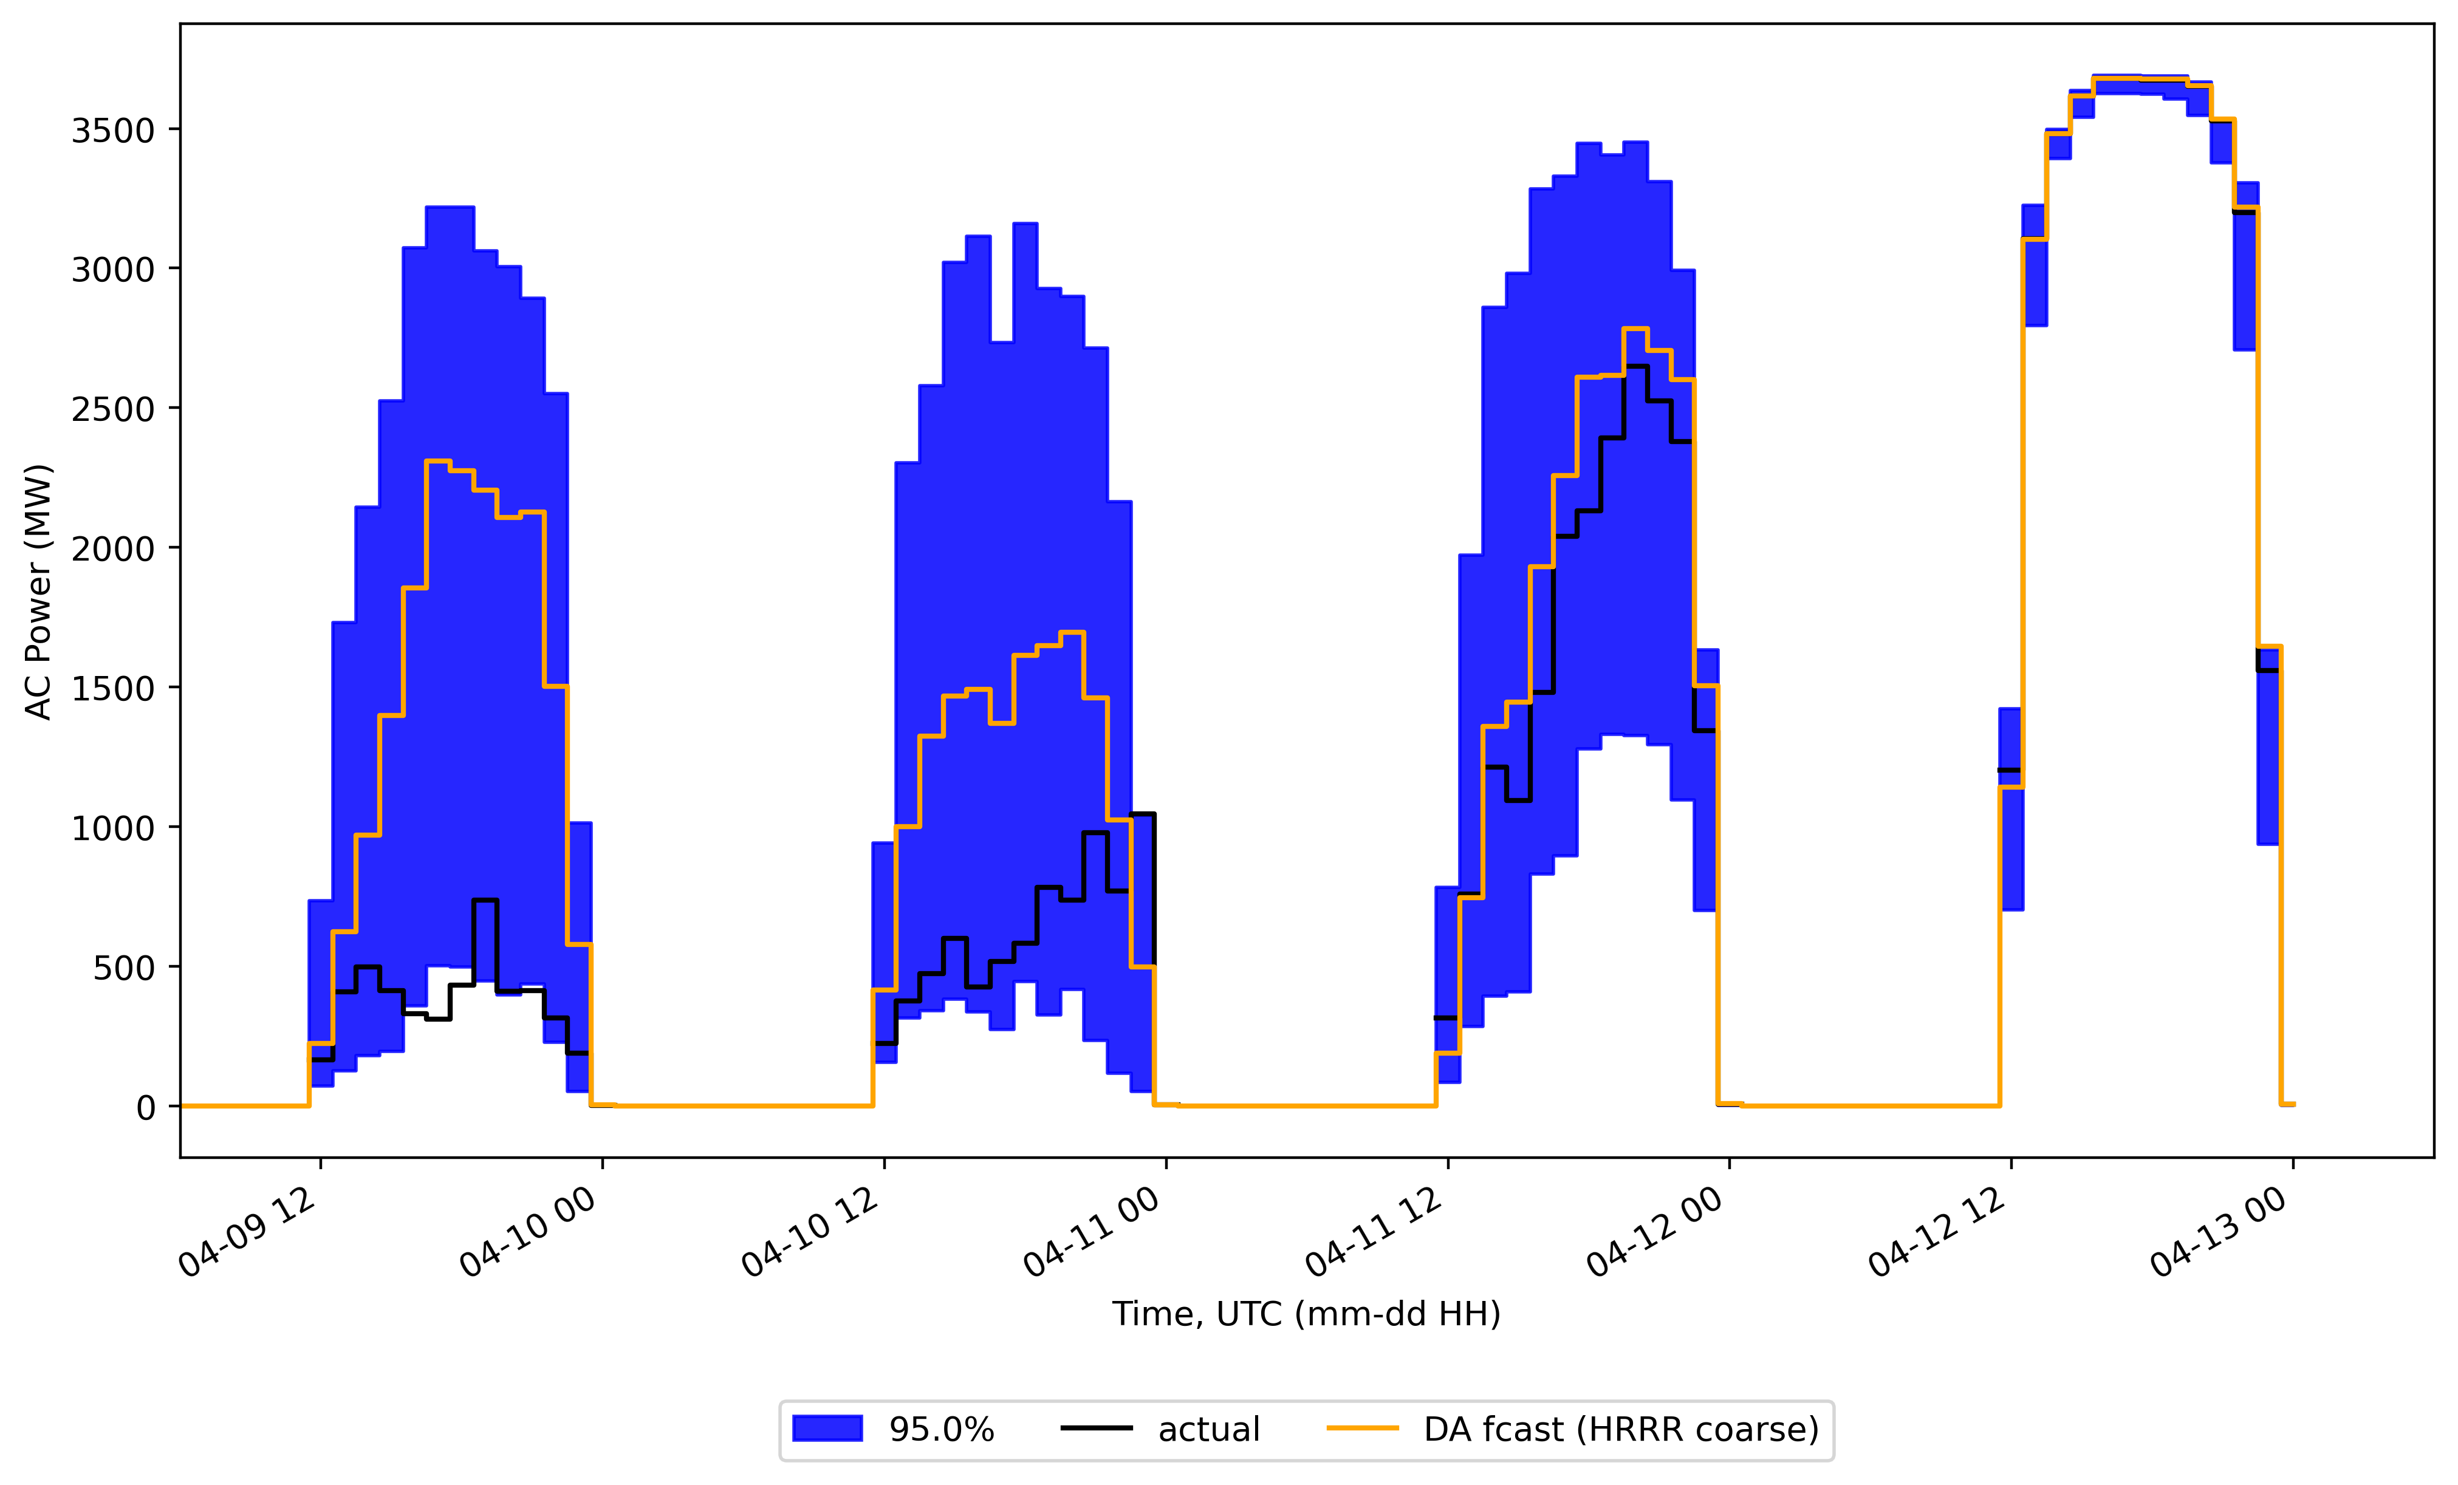

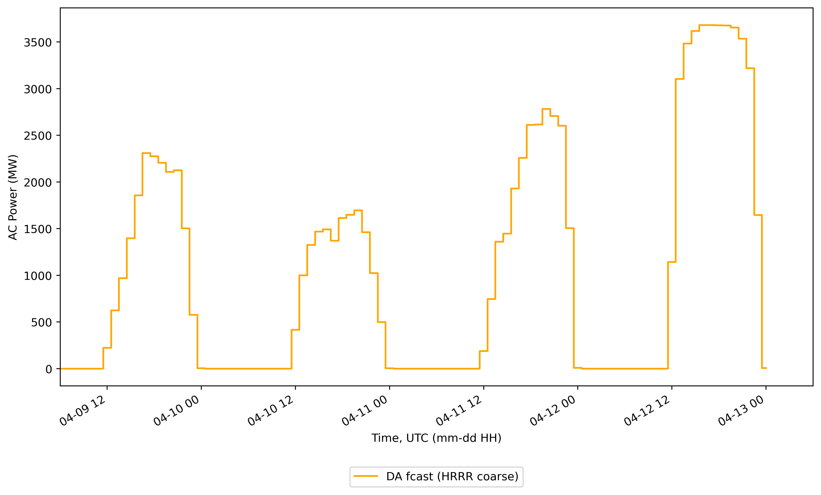



Sample Results
2.5x

Slide 42
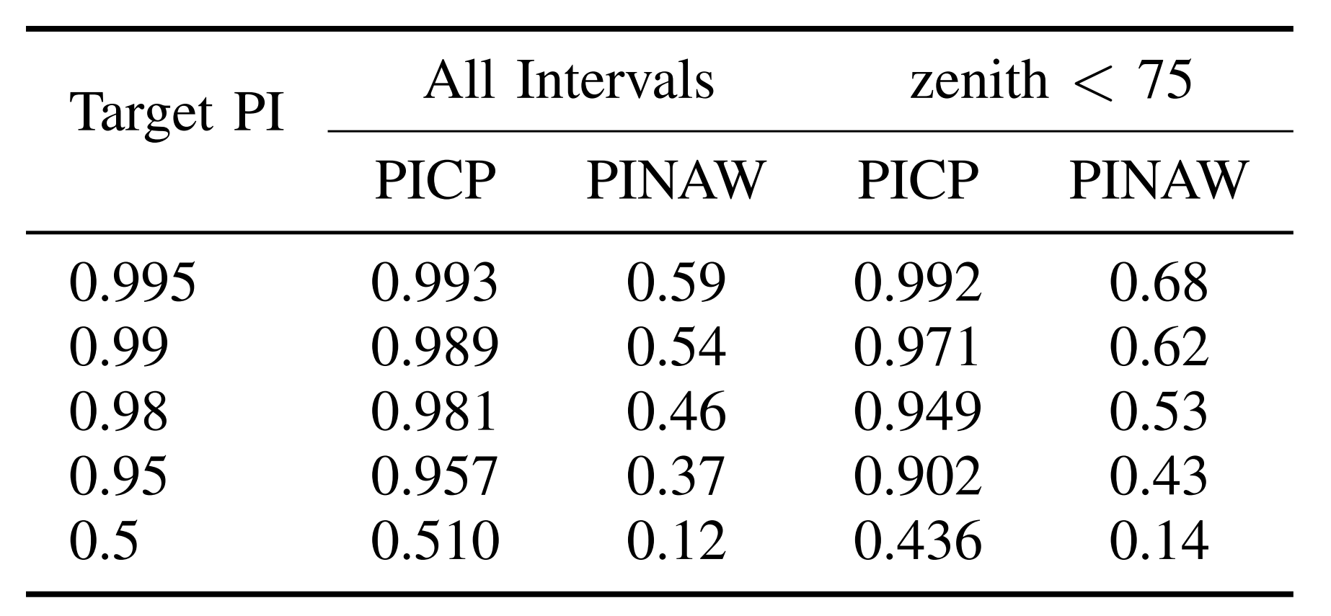



Performance Statistics over 2023
“reliable”
PICP: Prediction Interval Coverage Probability
What fraction of observations fall in a prediction interval, e.g., 95% P.I.?
PINAW: Prediction Interval Normalized Average Width
Just because 95% of obs. fall in the 95% P.I. doesn’t mean it’s helpful…
Normalized to clear sky
“sharp”

Slide 43
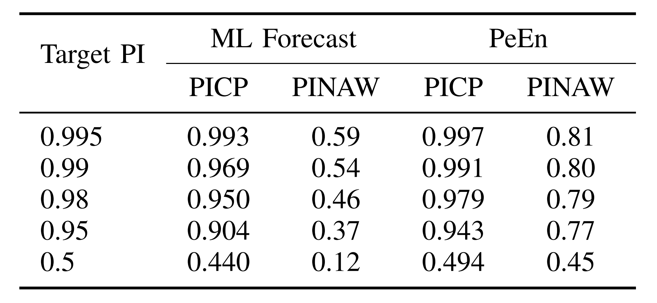


Comparison with Persistence Ensemble
Persistence Ensemble, PeEn: Like a historical PDF
(removed intervals where obs. was 0% of clear sky)

Slide 44
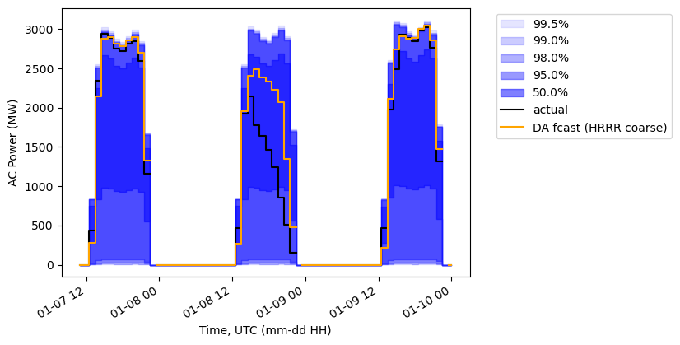
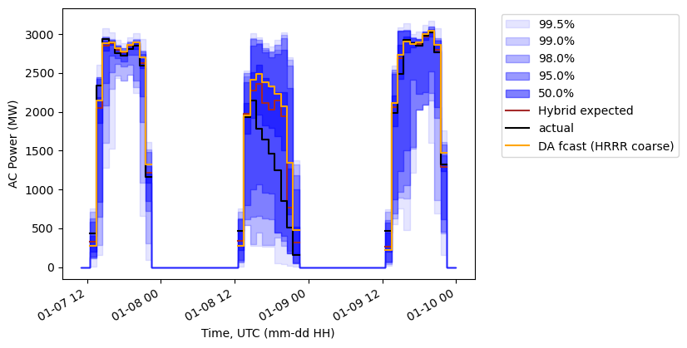
Visual Comparison:
PeEn
ML

Slide 45
Timeout!
Of course it’s better than persistence! How do you know it’s actually useful??
Great question! I don’t know that, but:
EPRI OPTSUN [1] showed potential for reliability improvements with no cost increase by using probabilistic forecasts
These forecasts appear to be better than the ones used for Southern’s system in OPTSUN
These forecasts only get better with a better deterministic forecast
[1] https://www.epri.com/optsun, see W. Hobbs, “Probabilistic Methods in Operations”, ESIG 2022 Spring Workshop for my summary (recorded: https://www.youtube.com/watch?v=1aO4kOoR2nc&t=1370s)

Slide 46
Operational Deployment Considerations
Runs in < 15 minutes on my 4-year-old laptop
Retraining with representative observations and deterministic forecasts
Account for changes over time: increasing sites, plant availability
Consider a reforecast (a.k.a., historical forecast, “hindcast”) from the deterministic forecast provider
Consider supplementing observations with satellite-based irradiance (plus power model) to build a longer history of newer fleet
Especially if you don’t want outages included in forecast uncertainty

Slide 47
Areas for Future Work
Hyperparameter tuning
Shorter and longer forecast horizons (than day-ahead)
Extrapolation?
Improved features
Additional weather models
Ramp rate probability forecasts
Probabilistic net load

Slide 48

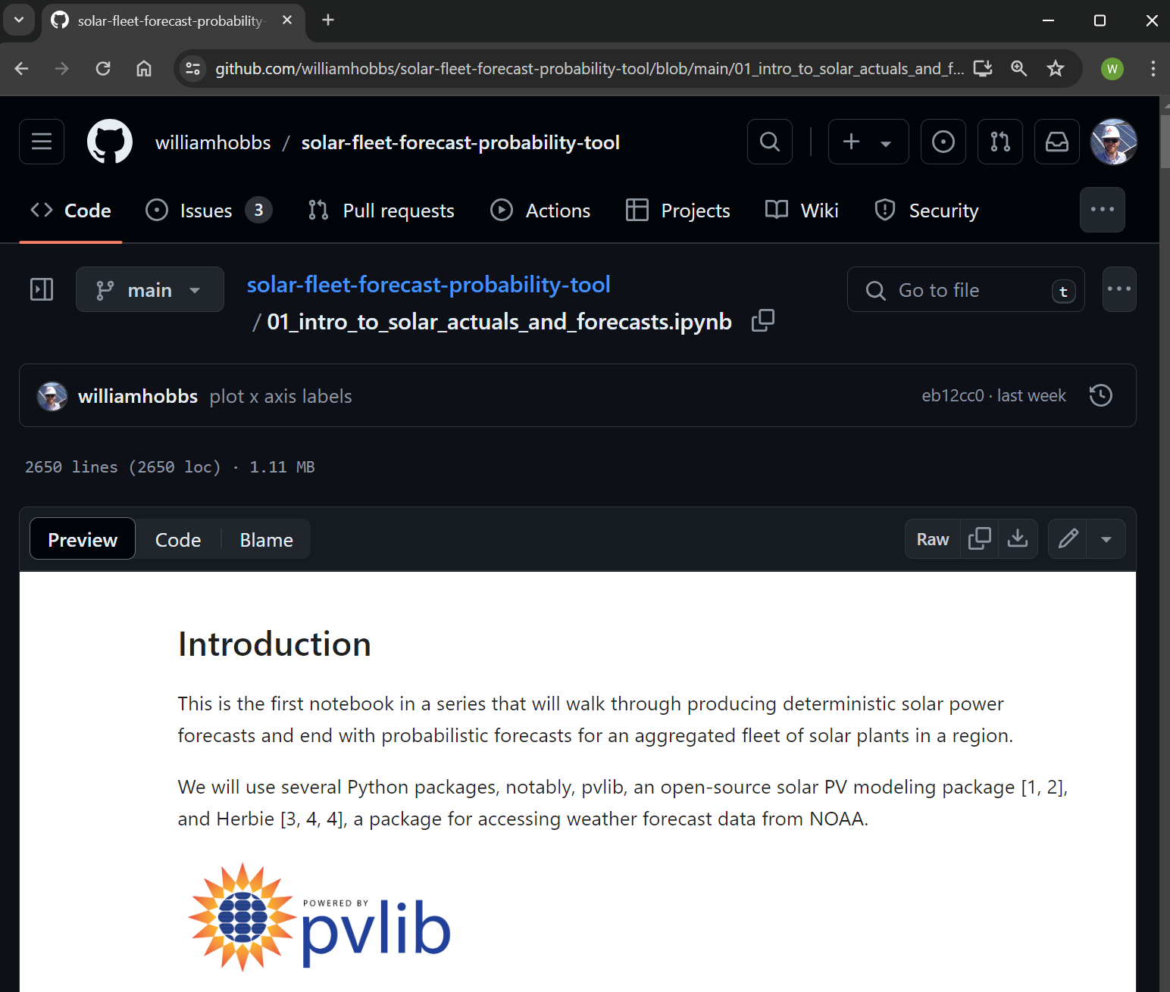
Available Code
github.com/williamhobbs/solar-fleet-forecast-probability-tool
BSD-3-Clause License
Python, with Jupyter Notebooks to run everything yourself
Please let me know if you use it!

Slide 49
Questions? whobbs@southernco.com
github.com/williamhobbs/solar-fleet-forecast-probability-tool

Slide 50
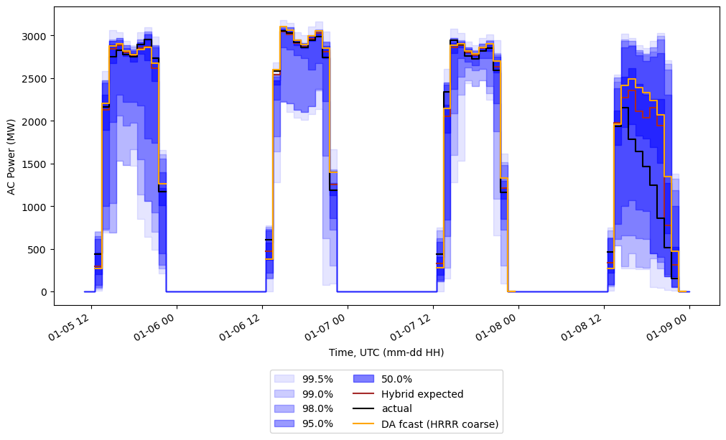
Sample data
January

Slide 51
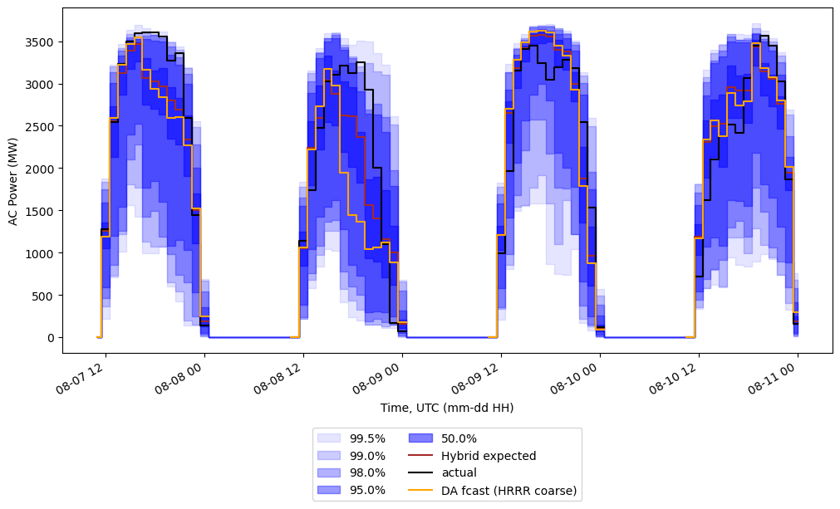
Sample data
August

Slide 52
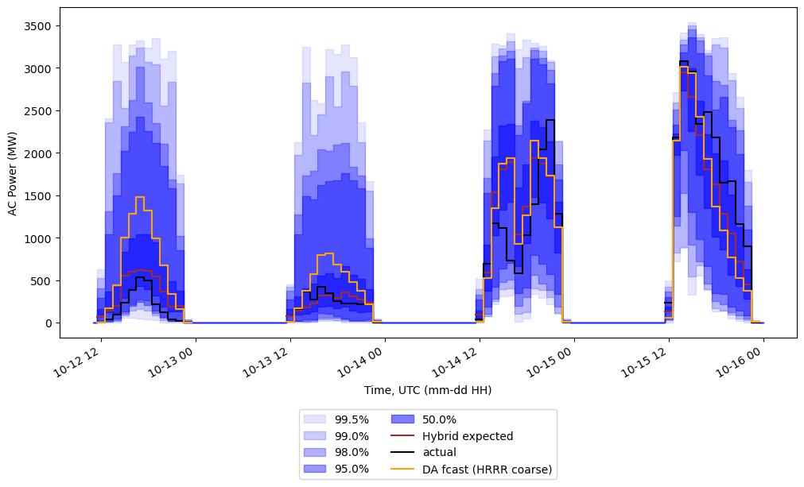
Sample data
October

Slide 53
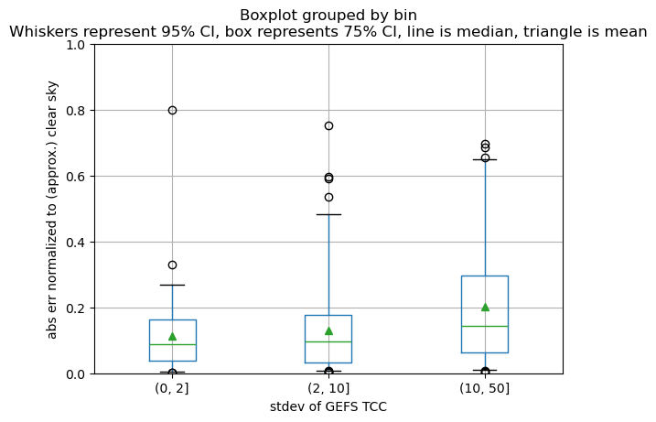


Using this uncertainty information
Sometimes, there is a clear relationship between error and the GEFS ensemble spread (standard deviation of total cloud cover, or TCC):
(Jan. 2021)

Slide 54
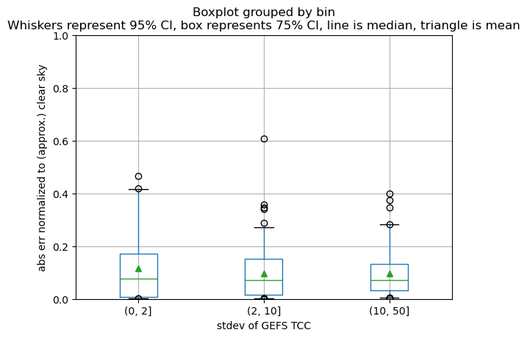

Using this uncertainty information
… but not always
(Apr. 2021)

Slide 55
Quantiles
Quantile examples:
0.5 is 50th percentile, or expected value
0.95 is 95th percentile
Can be used for prediction intervals, e.g., 0.95 and 0.05 bound the 90% prediction interval (expect actual to fall in that range 90% of time)

